Slide 2
BROCHURE
iRISKTM

Slide 3
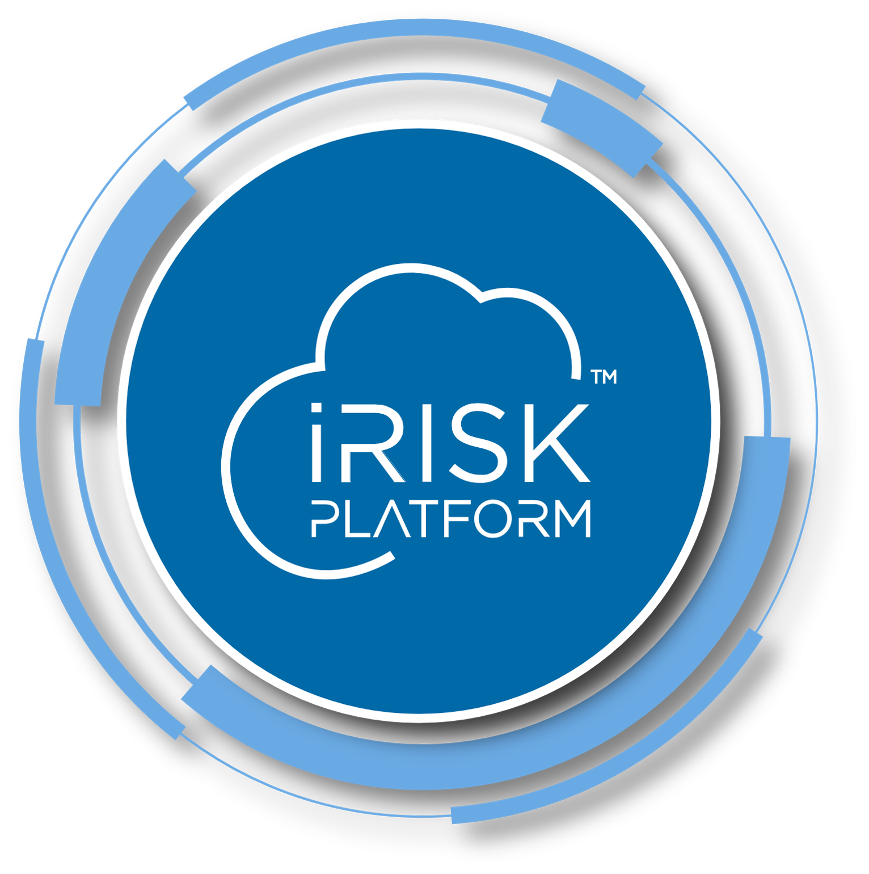
iRISKTM is a next generation Risk Management Platform for the pharmaceutical industry, developed according to the industry's best practices and influenced by SMEs on the area, to develop risk and science based strategies for products, processes and other elements, in a systematic and compliant way.
iRISKTM integrates, in a single platform, functionalities to manage risk and knowledge, allowing companies to streamline their processes throughout the lifecycle of their products and accounting for all areas of the pharma environment

Slide 4
MEET iRISKTM

Slide 5
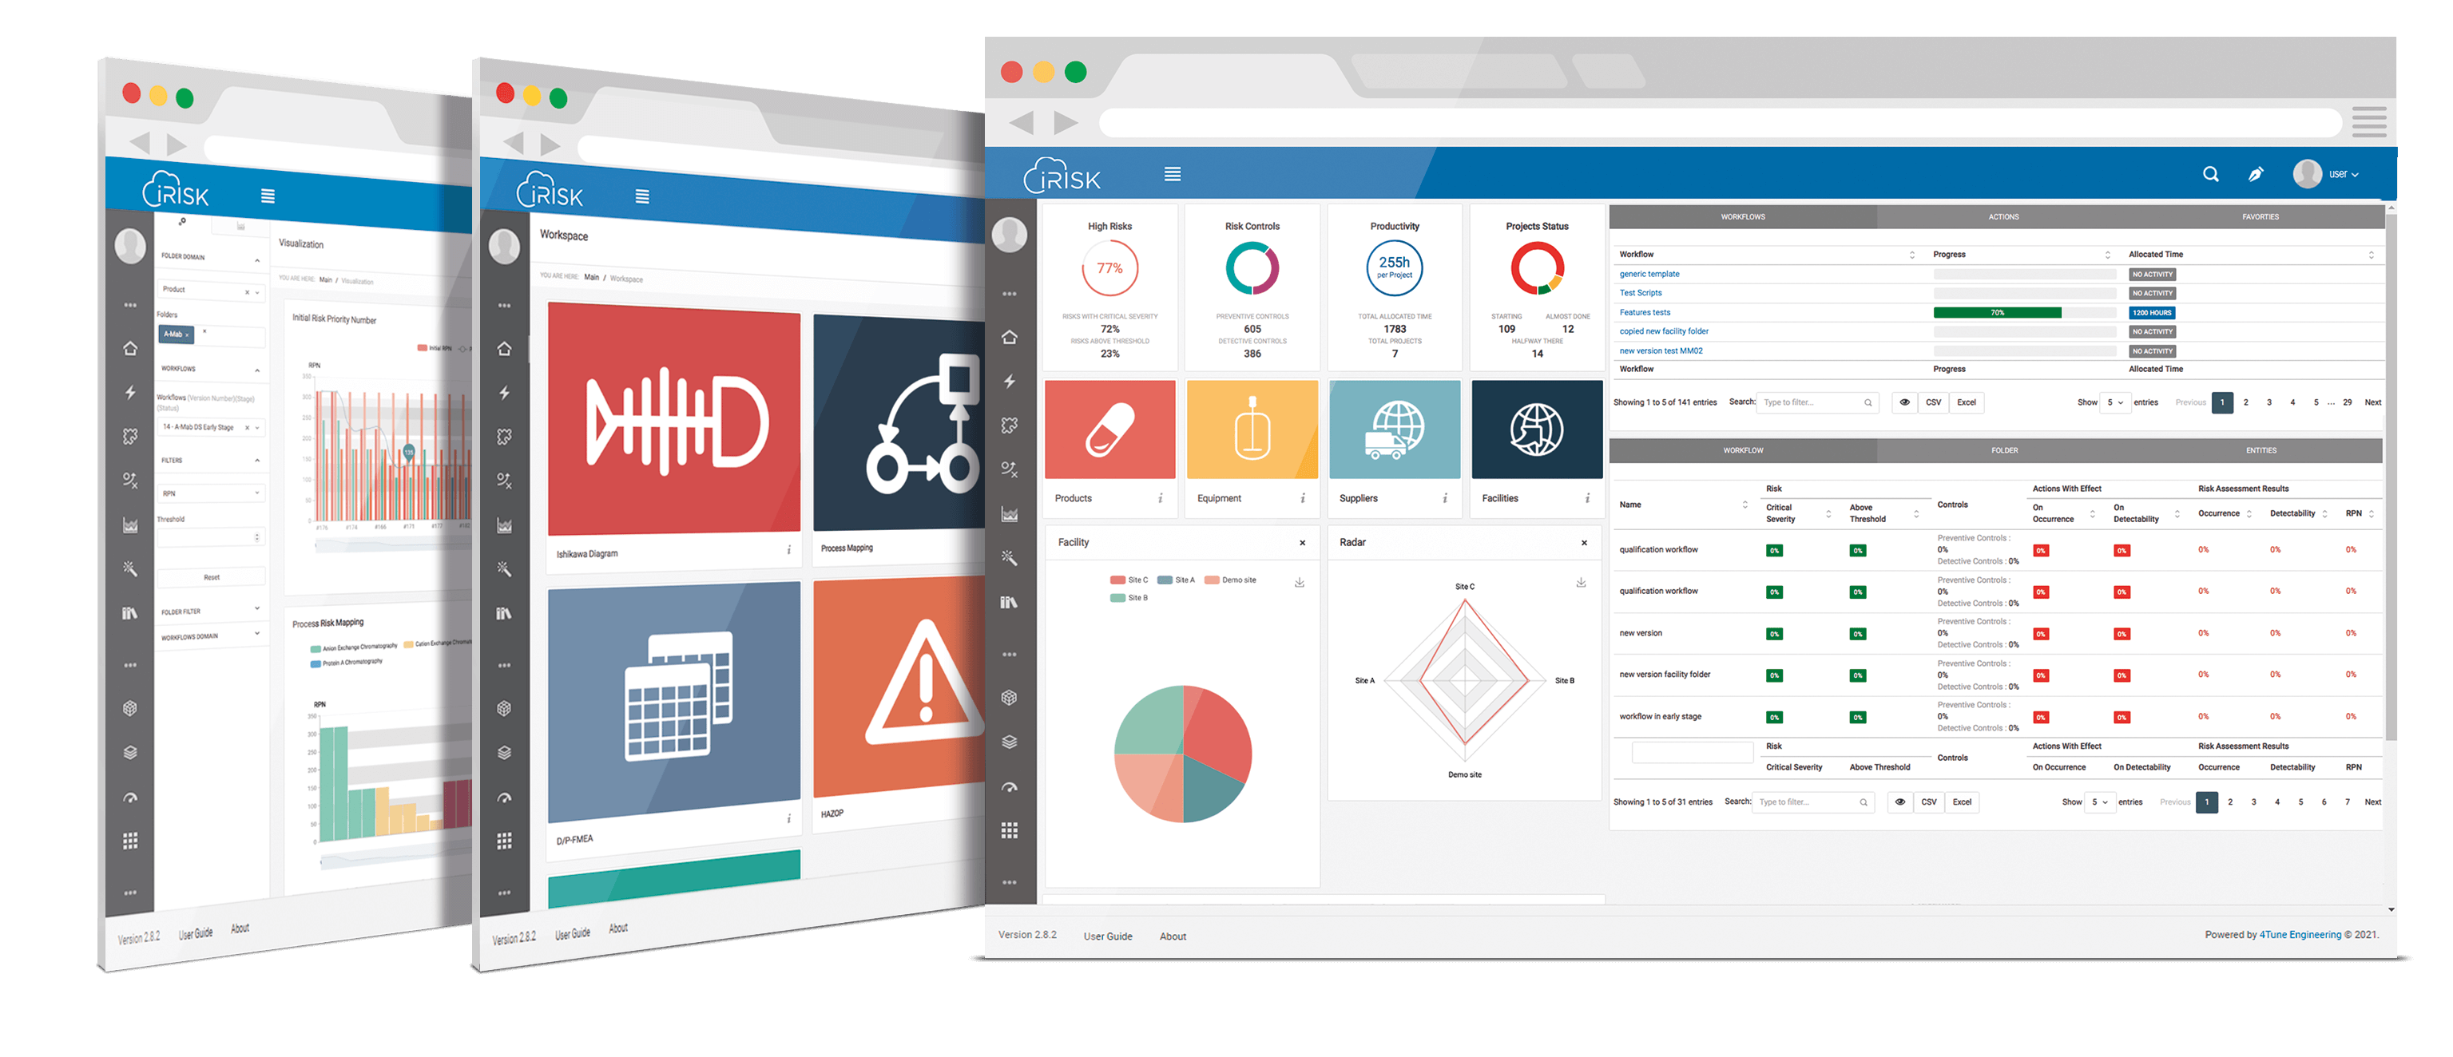
MEET iRISKTM
STAYING COMPLIANT BECOMES EASY
With the increased demands for risk-based decisions, companies need corporate solutions supporting integrated Quality Risk Management processes that are digital and flexible enough to cover the whole product lifecycle.
iRISKTM enables just that by applying the best principles and tools,
ensuring that your risk activities are aligned with FDA, GMP-Annex 15, EMA and ICH guidelines.

Slide 6
WHAT CAN iRISKTM DO FOR YOU ?

Slide 7
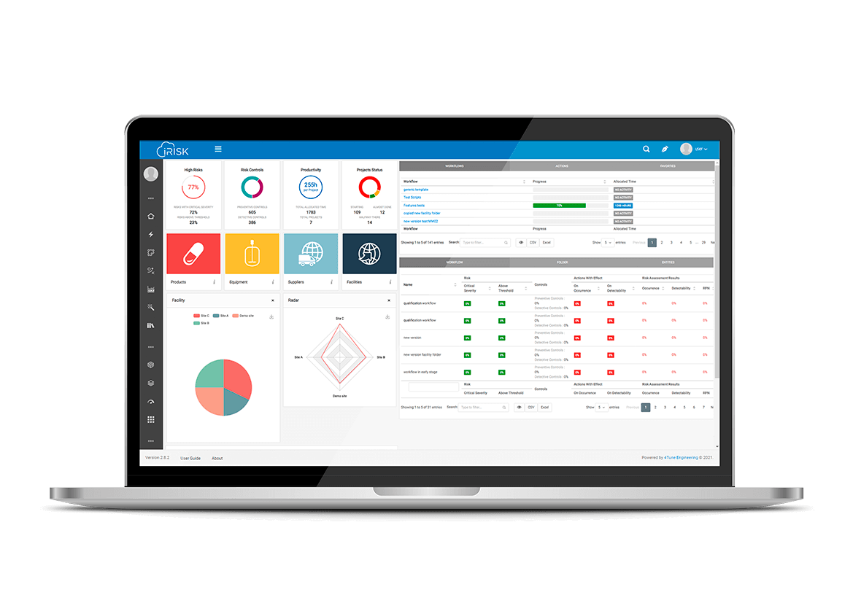
WHAT CAN iRISKTM DO FOR YOU ?
STAYING COMPLIANT BECOMES EASY
Facilitate cross-functional and cross-company cooperation for optimal business results.
Faster time-to-market with efficient and robust development.
Manage the pool of knowledge across the organization.
Compare risk profiles of different strategies to make agile risk-based decisions.
Efficient change control / change management.
Measure the efficacy of the actions taken.
Provide decision-makers with “traffic lights” (good, warning, alert).
Stay on the compliance forefront.
BETTER DECISIONS

Slide 8
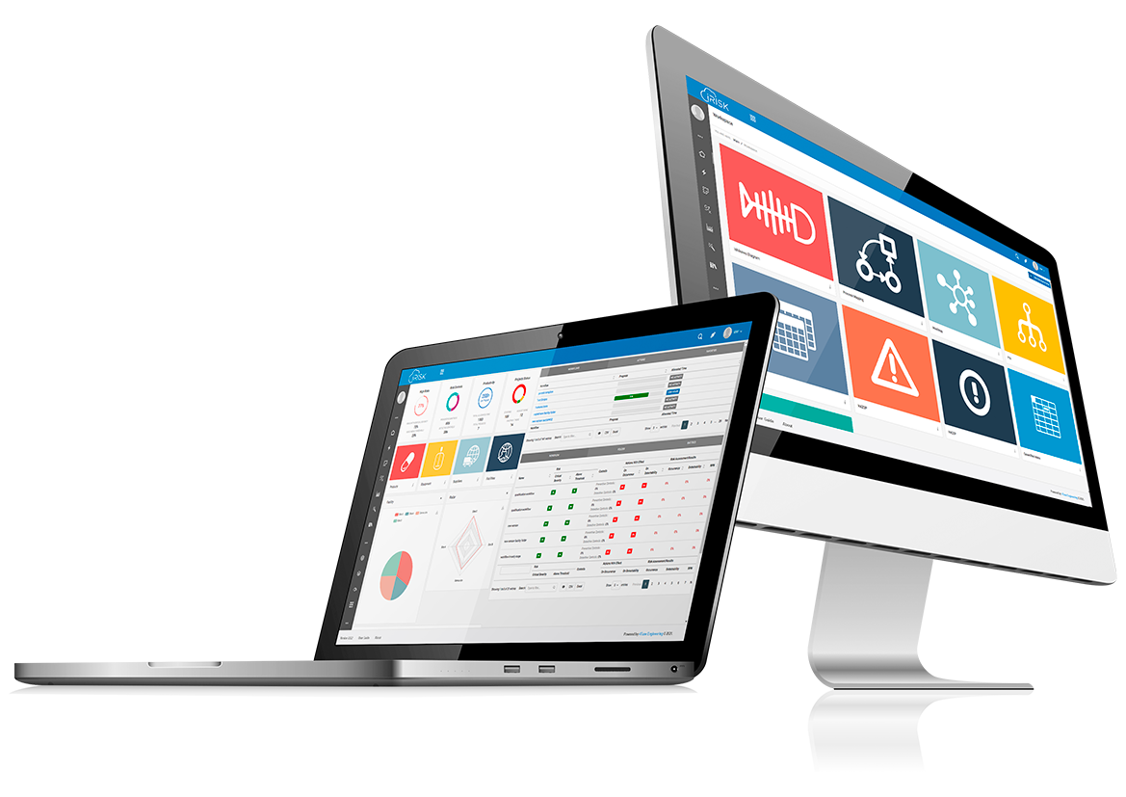
WHAT CAN iRISKTM DO FOR YOU ?
MADE TO SUPPORT YOUR DIGITAL TRANSFORMATION
Perform your Risk Mapping on top of process mappings;
Seamlessly interconnect all your key risk-tools;
Apply disciplined and context-specific workflows built with a Knowledge Management approach;
Formulate your Risk Mitigation and Control Strategies and compare the Risk Profiles of your assessments over the lifecycle;
Assure that your Data is Attributable, Legible, Contemporaneous, Original and Accurate;
Guarantee both ISO 9001:2015 and GAMP5 compliance;
Access it as either a web or cloud-based platform, with unlimited user capacity;
Access tools for Prior-Knowledge Harvest & Criticality Assessment;
Generate comprehensive reports with the Report Builder Assistant;
Manage your audit trail, security, electronic records and signatures in accordance with FDA’s 21 CFR Part 11.

Slide 9
WHAT IS INSIDE iRISKTM ?

Slide 10
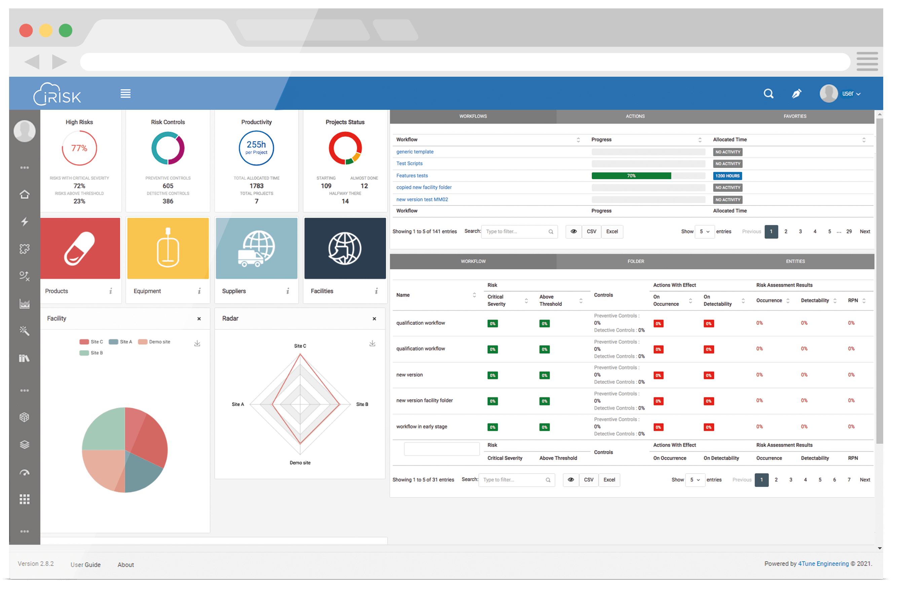
WHAT IS INSIDE iRISKTM ?
STAYING COMPLIANT BECOMES EASY
Customizable dashboards for visualization of risk status
Different layers of information according to user roles
Metrics
Visualize high risks, control strategies, user productivity and Manage projects
Project Overview
Workflows with risk reduction scoring and effectiveness of the action plan
Customization
Visualization charts
per site, per product, per equipment and
others

Slide 11
WHAT IS INSIDE iRISKTM ?
MANAGING THE RISK IN YOUR
ENTIRE ORGANIZATION
iRISKTM allows you to configure specific entities, around which you can build your assessments and generate knowledge.
Easily map out your quality attributes, process parameters and operations, for all stages of the product lifecycle;
Correlate, in an intuitive way, all the elements of your process, to discern all the critical elements, in a science-based approach;
Evaluate, mitigate and design robust control strategies, aligned with QbD practices, aimed to promote product consistency and compliance.
Easy qualification and validation of equipment through Installation Qualification, Operational Qualification, Performance Qualification and Validation Plan;
Agile and successful selection of equipment for each application, based on solid risk-based considerations.
Manage your entire supplier lifecycle in one place, from its selection until its approval;
Configure specific questionnaires, tailored to your requirements, to ensure fit-for-purpose assessments and accurate
decision-making;
Map out your supply chain, identify potential risks and act on them, based on justified rationales.

Slide 12
WHAT IS INSIDE iRISKTM ?
Enhanced knowledge management capabilities across multiple sites;
Design fitting CQV plans to manage all the validation aspects of your facilities and production sites;
Perform cross-area and cross-site assessments, including cross-contamination and tech-transfer assessments, in a systematic approach.
Assess the best method according to its intended application, using a tailor-made risk workflow;
Connect risks of the methods and products for a holistic view of their impacts;
Build robust analytical strategies, driven by the best practices of the industry.
Configure your specific entities, based on your assessment requirements, and use iRISKTM to drive a systematic and thorough
assessment that matches your needs and adds value.
And much more!

Slide 13
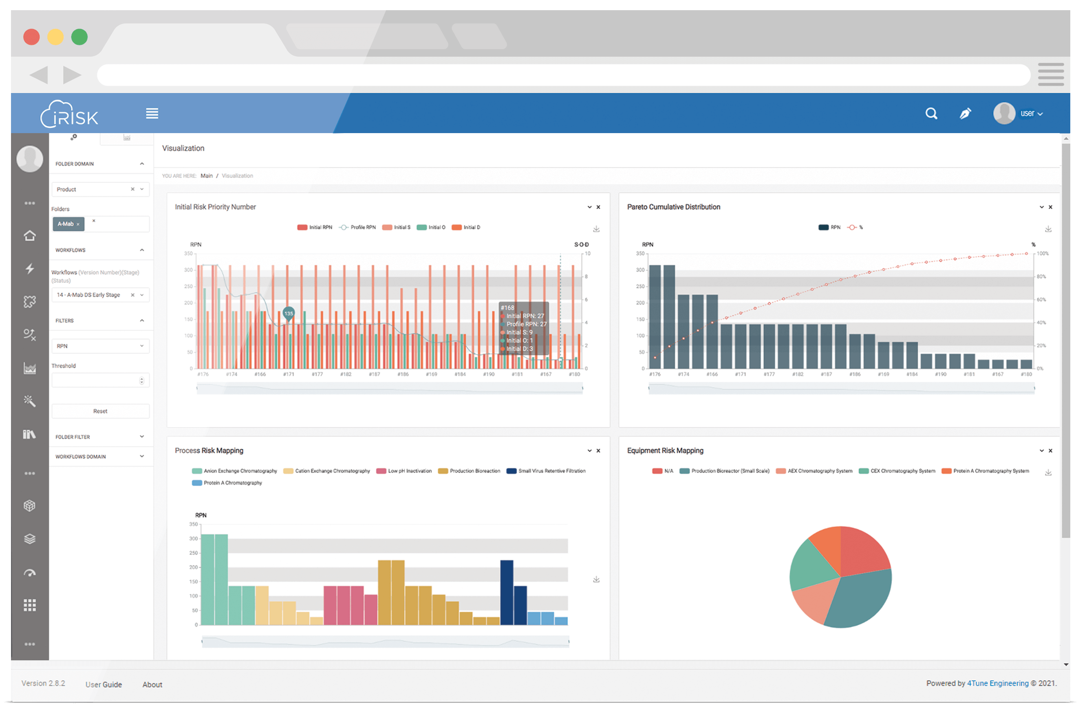
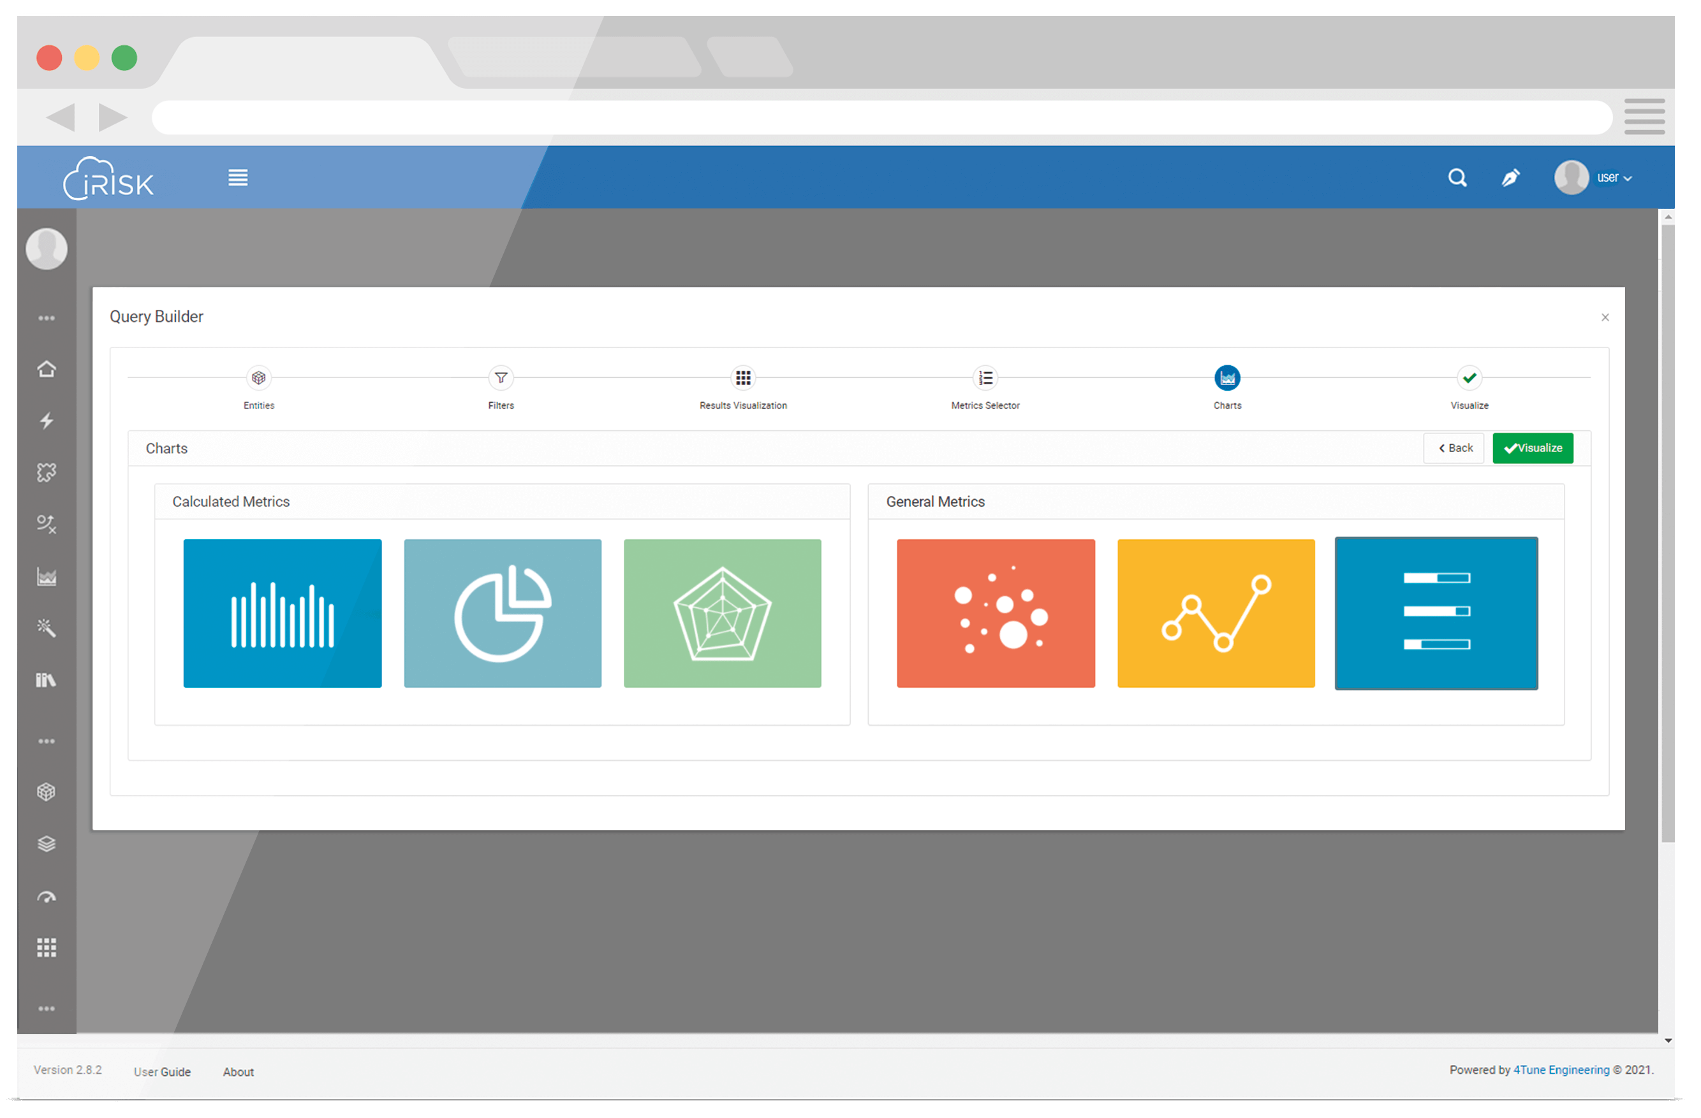
WHAT IS INSIDE iRISKTM ?
VISUALIZATION & QUERIES
Take full advantage of iRISKTM's embedded visual capabilities, by analyzing the auto-generated graphics and maps or creating your own specific graphical queries

Slide 14
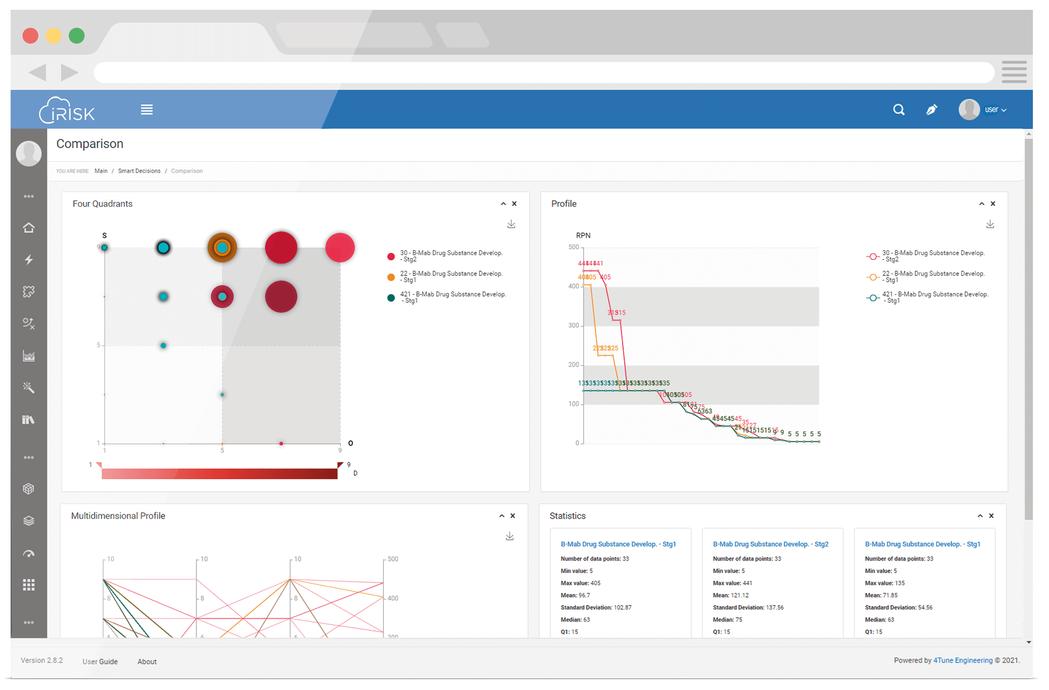
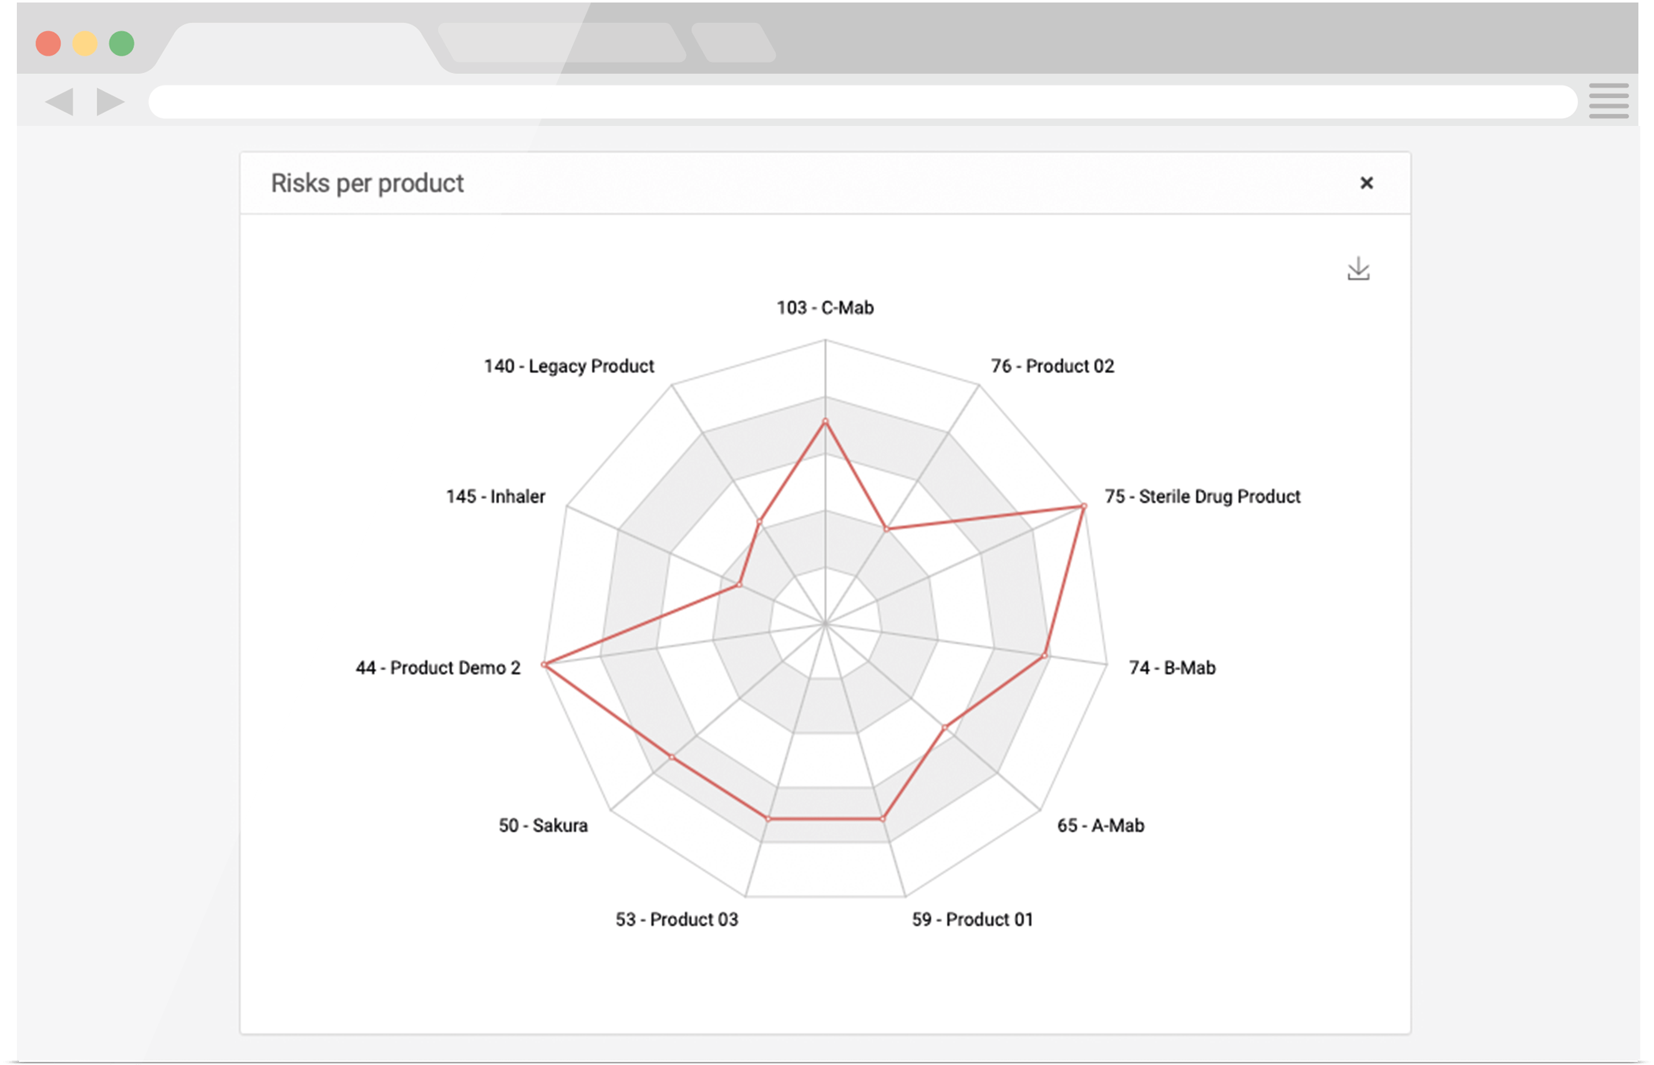
WHAT IS INSIDE iRISKTM ?
COMPARISON
Use iRISKTM's automatic comparison module to compare multiple assessments, at the same time and in a visual way. Take advantage of it to influence decision-making for tech tranfers, scale-up processes, post-approval changes and more!

Slide 15
WHAT IS INSIDE iRISKTM ?
VISUALIZATION & QUERIES
Take full advantage of iRISKTM's embedded visual capabilities, by analyzing the auto-generated graphics and maps or creating your own specific graphical queries

Slide 16
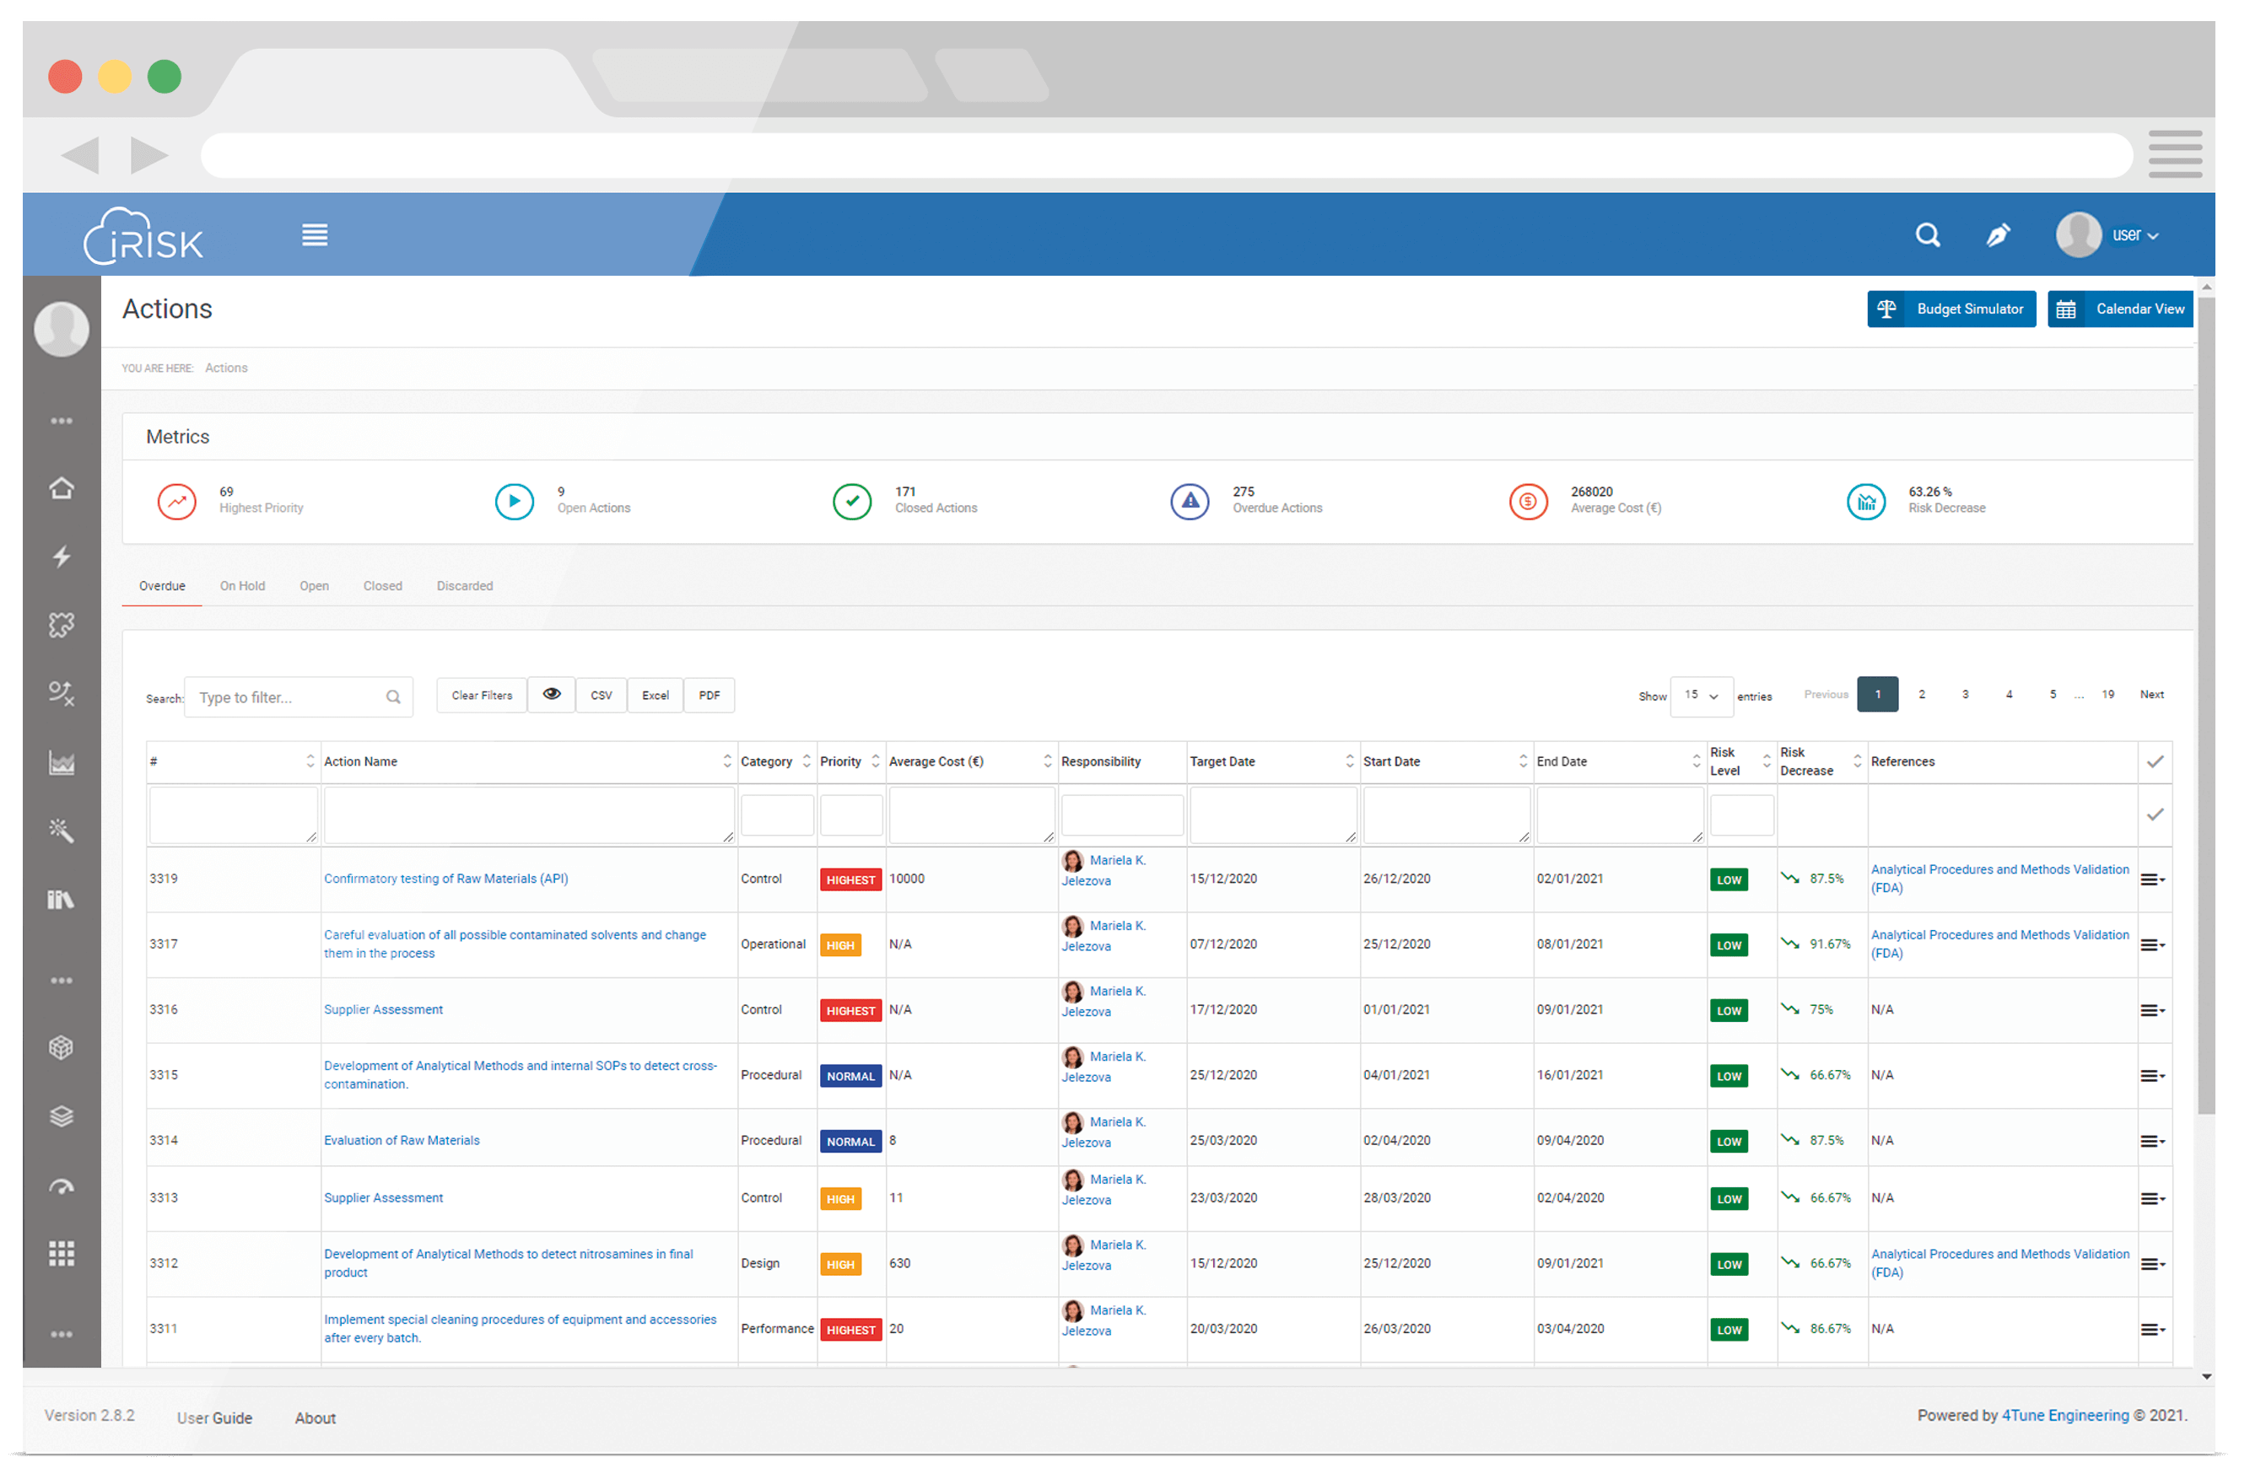
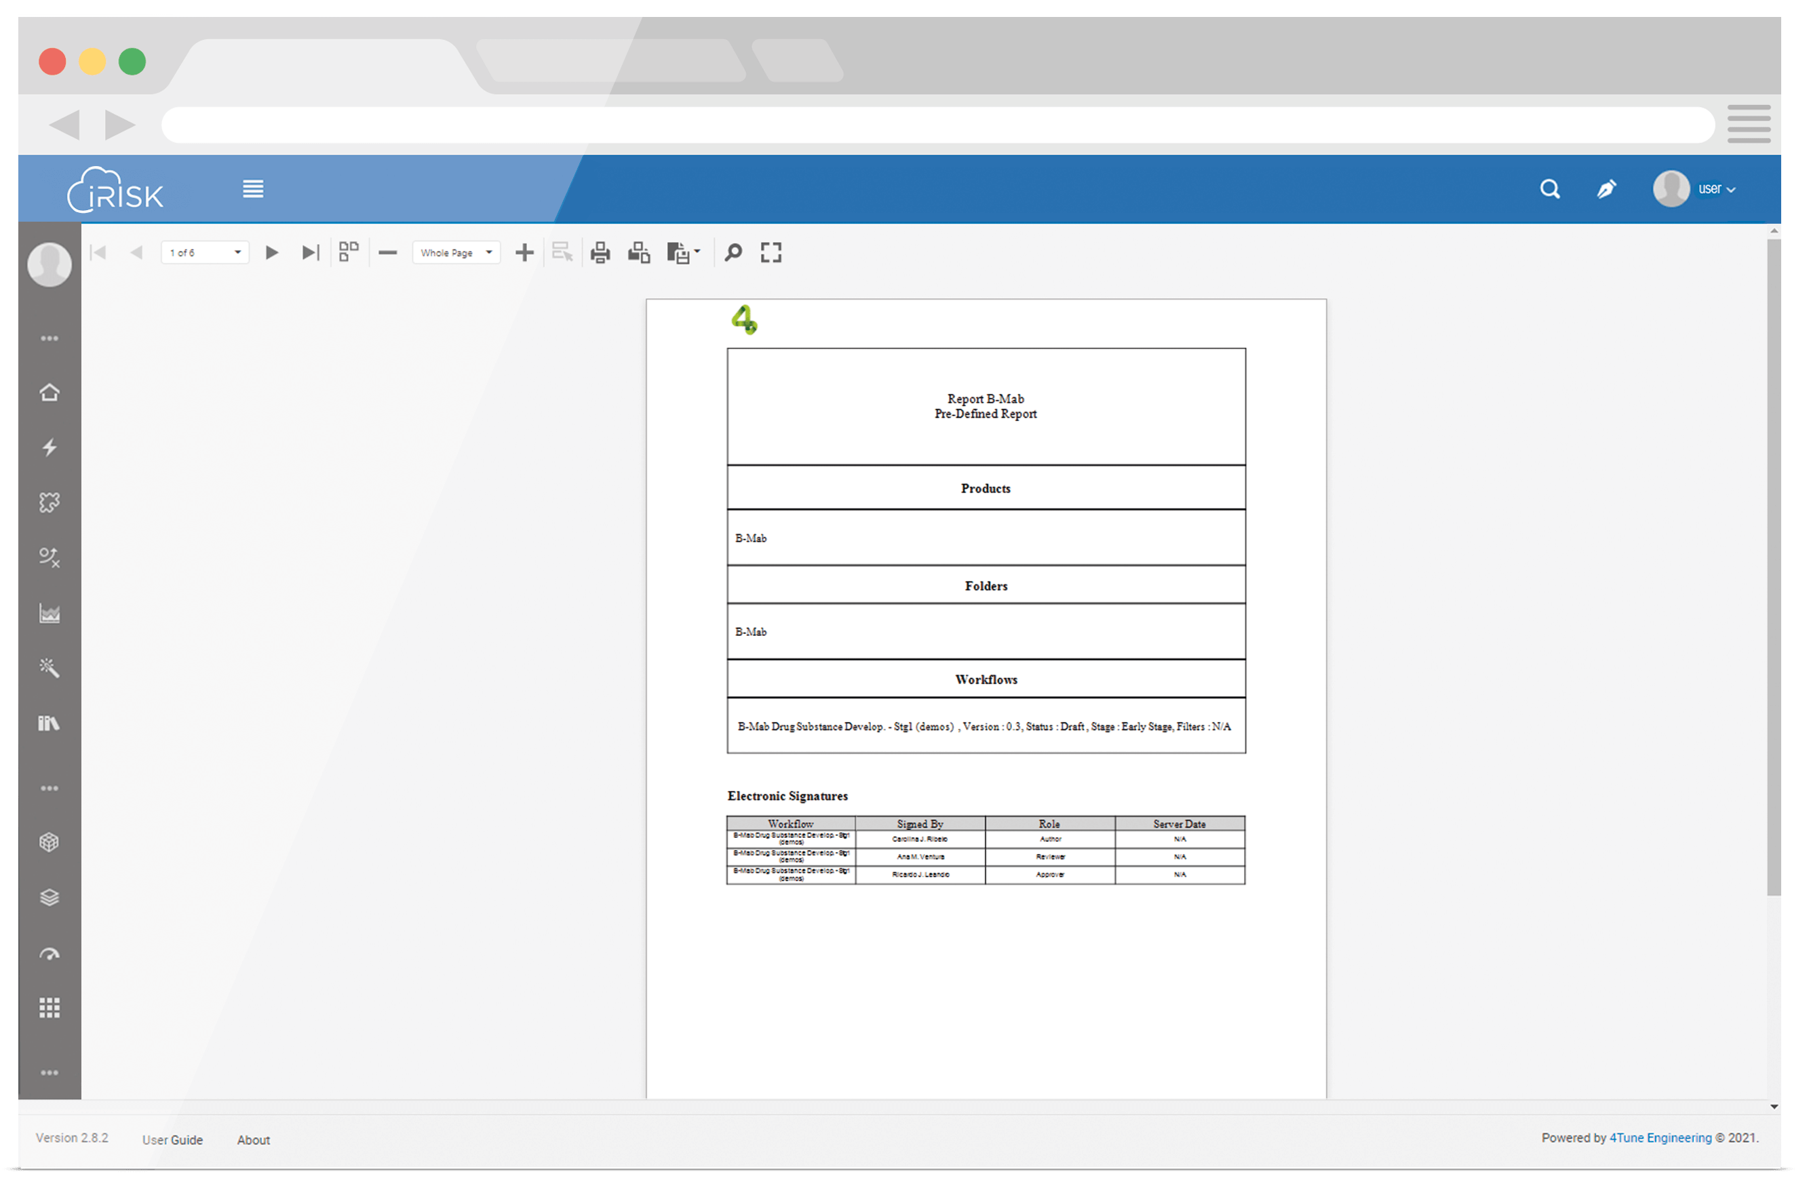
WHAT IS INSIDE iRISKTM ?
ACTION MANAGEMENT & REPORTING
Centralize all your management activities in iRISKTM's, using our action management module to monitor and control the implementation of actions and controls in your processes.
Build custom reports, at any point of your assessment, in an instant, using our specific report builder, for an easy and systematic access to the information generated in a risk evaluation.
PDF
XLS
XLSX
RTF
DOCX
MHT
HTML
JPG
SAVE

Slide 17
WHAT IS INSIDE iRISKTM ?
VISUALIZATION & QUERIES
Take full advantage of iRISKTM's embedded visual capabilities, by analyzing the auto-generated graphics and maps or creating your own specific graphical queries

