Slide 2
VLMS
Customer Name
Kevin Potts

Slide 3
About ValGenesis

Slide 4

About the company
Industry pioneer of digital validation
Product-focused, patented technology​
Expanding platform portfolio​
98+% renewal rate
Profitable, backed by Morgan Stanley
YoY growth over past 10 years
25+ global certified partners
550+ employees across 4 continents
Our Mission
To deliver you a platform for manufacturing intelligence that drives digital transformation, stronger compliance, and corporate efficiency.
Notes:
Our mission is simple: we want to provide you the industry’s only single platform for manufacturing intelligence. This holistic approach enables us to help you drive digital transformation, stronger compliance, and corporate efficiency.
You can see our qualifications and proof of success on the right.

Slide 5
Leadership by the numbers
1st
30
450+
18
To market
with a digitized
validation platform
Of the top 50 life
sciences companies
are customers
GMP
sites using
ValGenesis
Years of
double-digit
growth
Notes:
These are the numbers that matter.
We were first to market with a digital validation solution. Since our first customer, we’ve never accepted second place and we’ve never stopped innovating.
That’s enabled us to win the trust of more than half the world’s leading life sciences companies. Bayer. Roche. Stryker. Philips. And hundreds more.
In fact, many customers use across multiple sites. We’re currently deployed in more than 450 across the globe, and we’re trusted with validating hundreds of thousands of GMP assets.
And 18 years of growth speaks for itself.

Slide 6
The journey toward Pharma 4.0
Digital Maturity
Resources
Digitalization workforce 4.0
available and qualified
Information Systems
Holistic value network integration
and traceability
Pharma 4.0
Organization
Process holistic control and
strategy lifecycle management
Culture
Communication and
decision-making
Data Integrity by Design
Notes:
At the heart of ValGenesis’ platform for manufacturing intelligence is the goal of enabling companies to succeed in their Pharma 4.0 journey.

Slide 7
The ValGenesis platform for Pharma 4.0
STAGE 1
R&D
STAGE 2
Qualification & Validation
STAGE 3
Commercial Operations
Risk
Assessment
Development
Validation
Technology
Transfer
Quality
Metrics / Product
Reviews
Decommission
and Retire
Design
CQV
Control
Strategy Specifications
Change
Impact Assessment
Continuous Improvement
ValGenesis iRisk
ValGenesis Process Manager
ValGenesis Validation Lifecycle Management
ValGenesis Process Insight
ValGenesis e-Logbook
Consulting Services (Internal + Partner)
Notes:
This is a high-level map of our platform.
The GxP stages going across should be familiar to all of you.
Below that, you can see our products span these stages.
Today we’ll be talking about XXXXXXXXXXXXX.

Slide 8




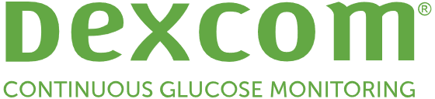
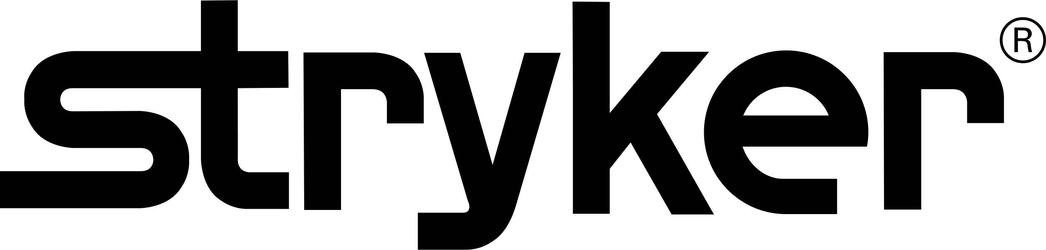








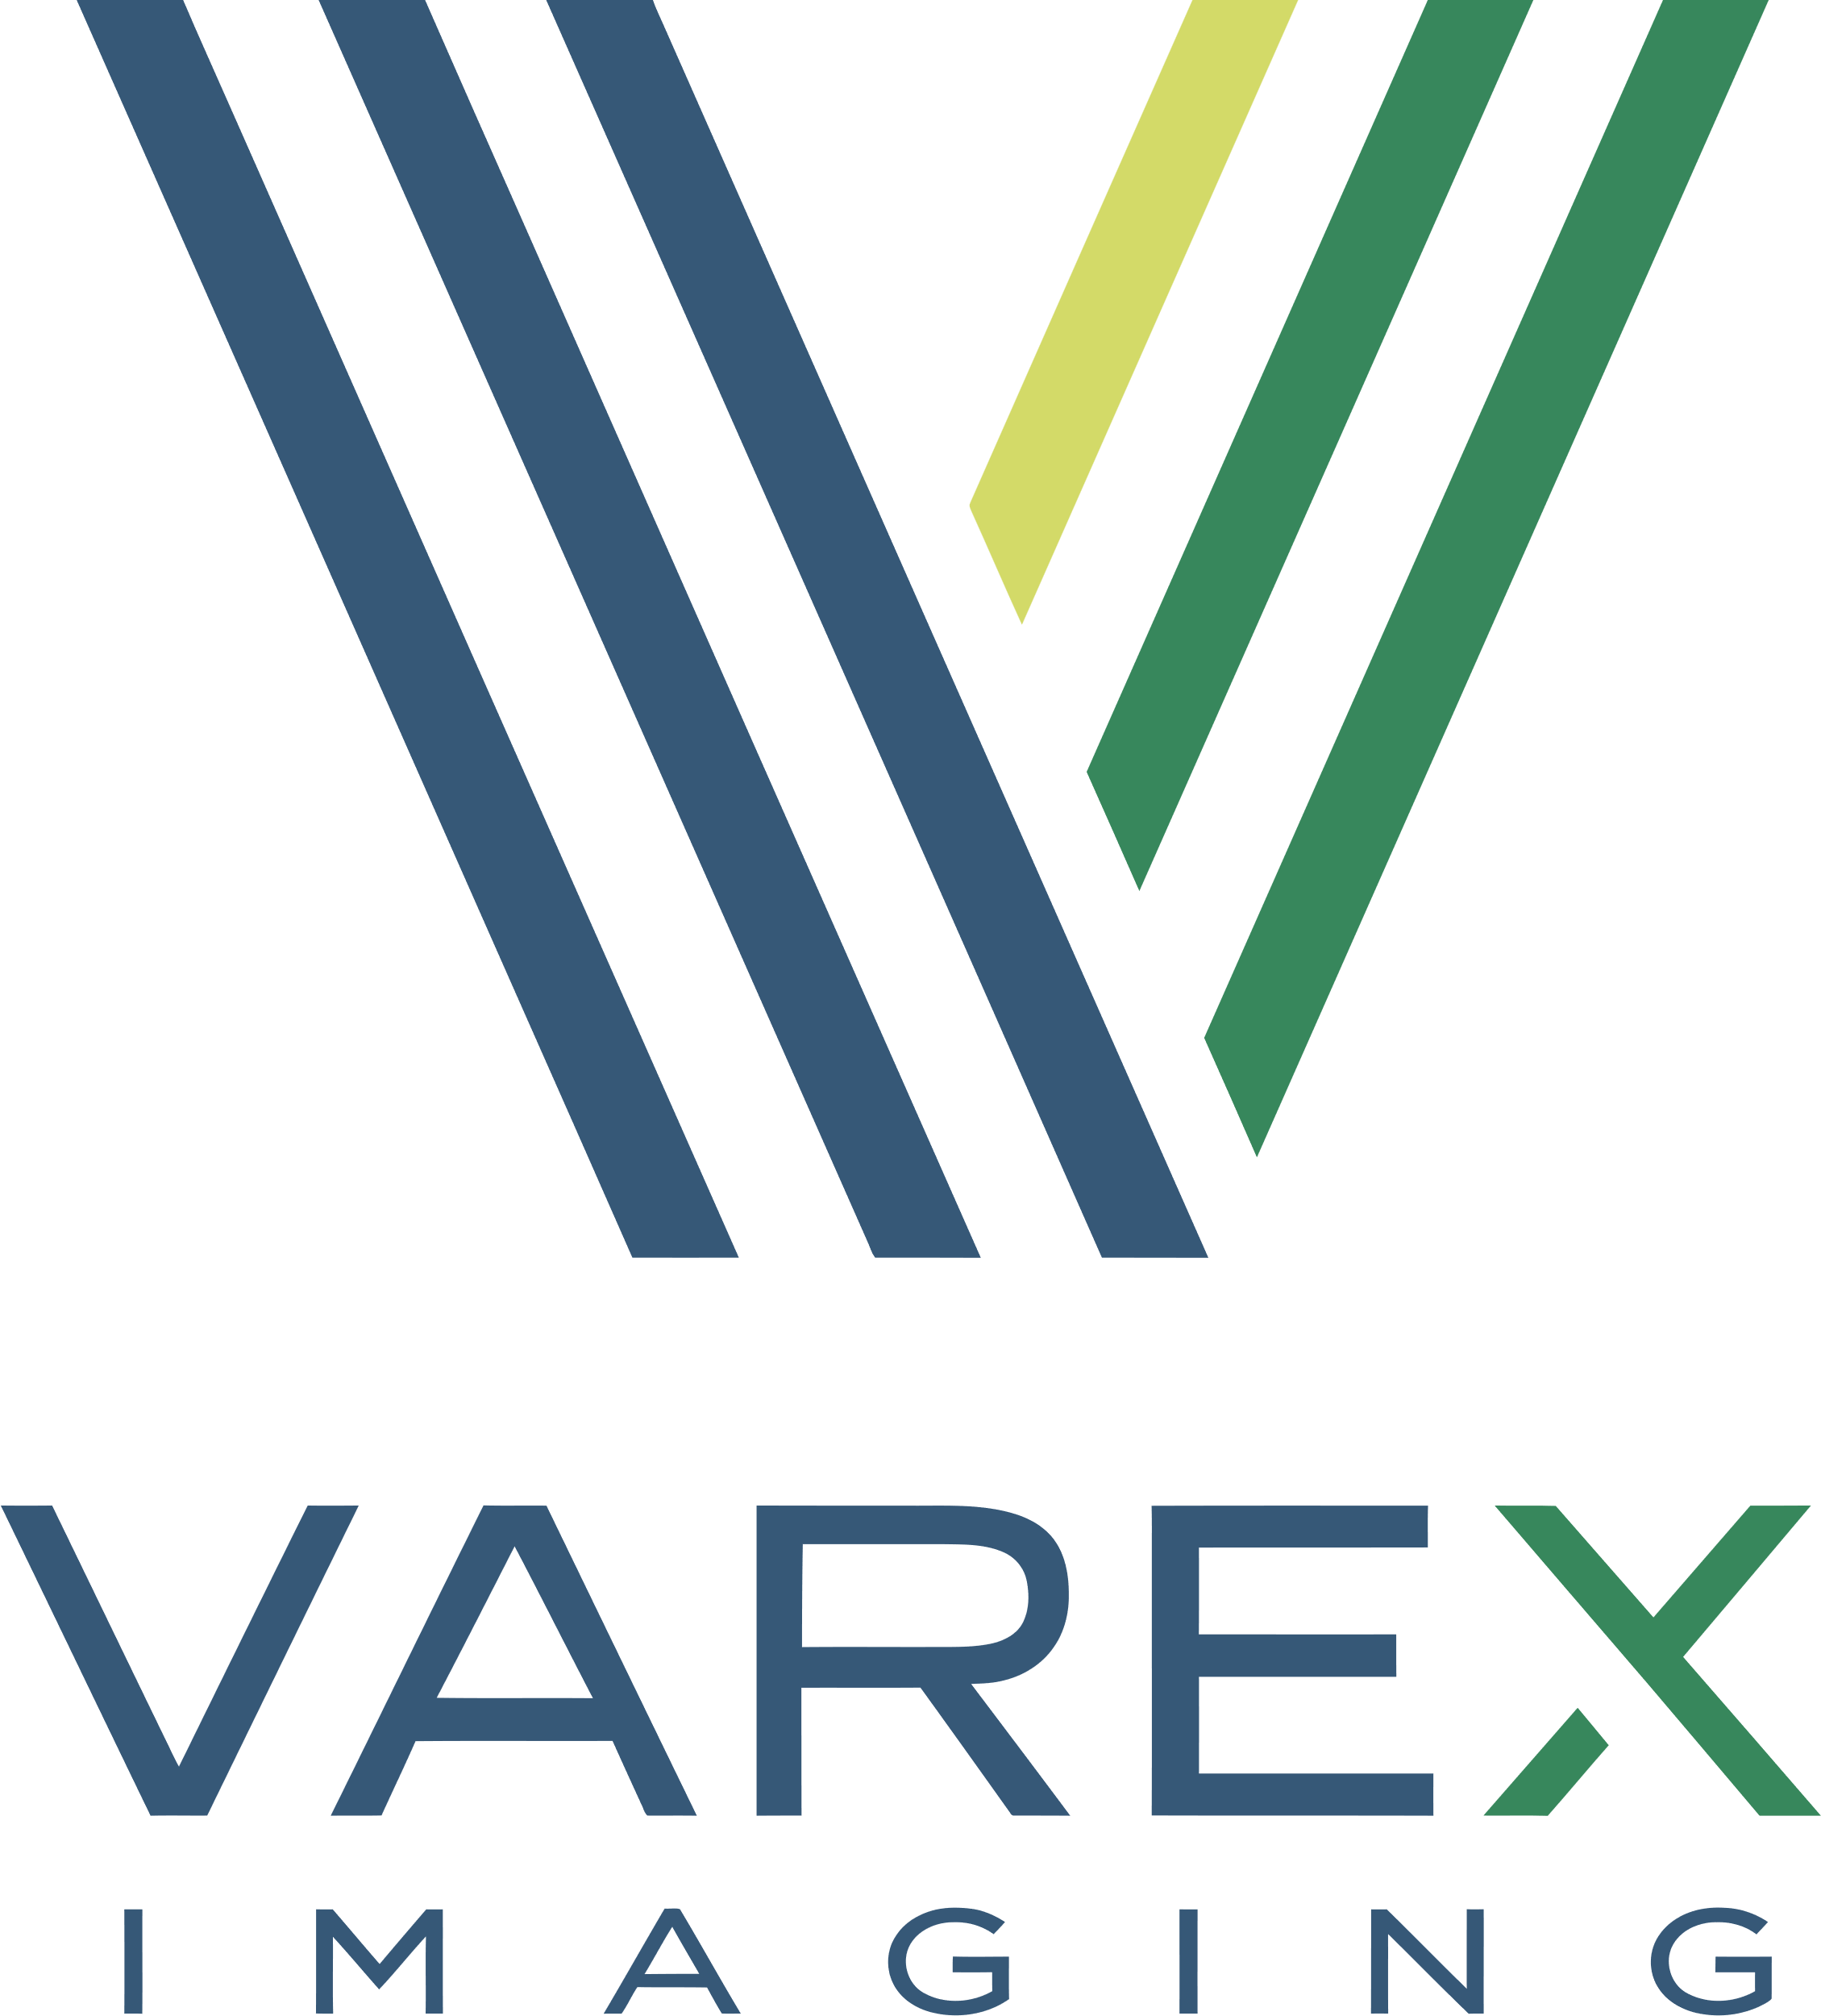









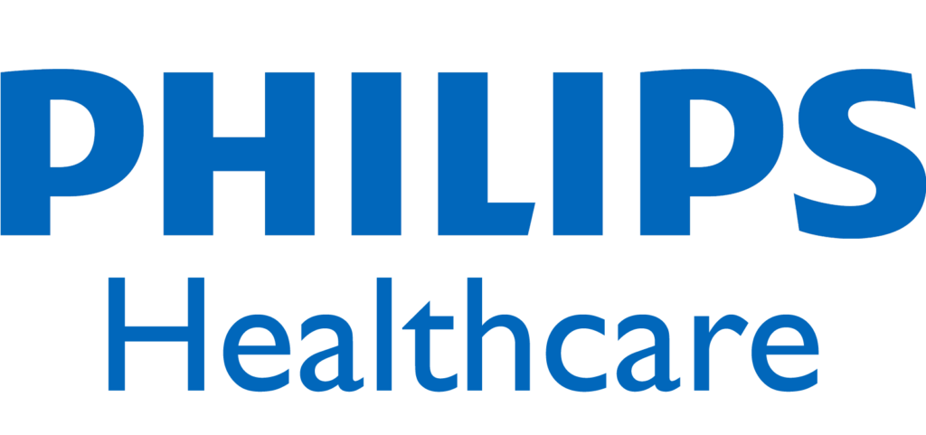
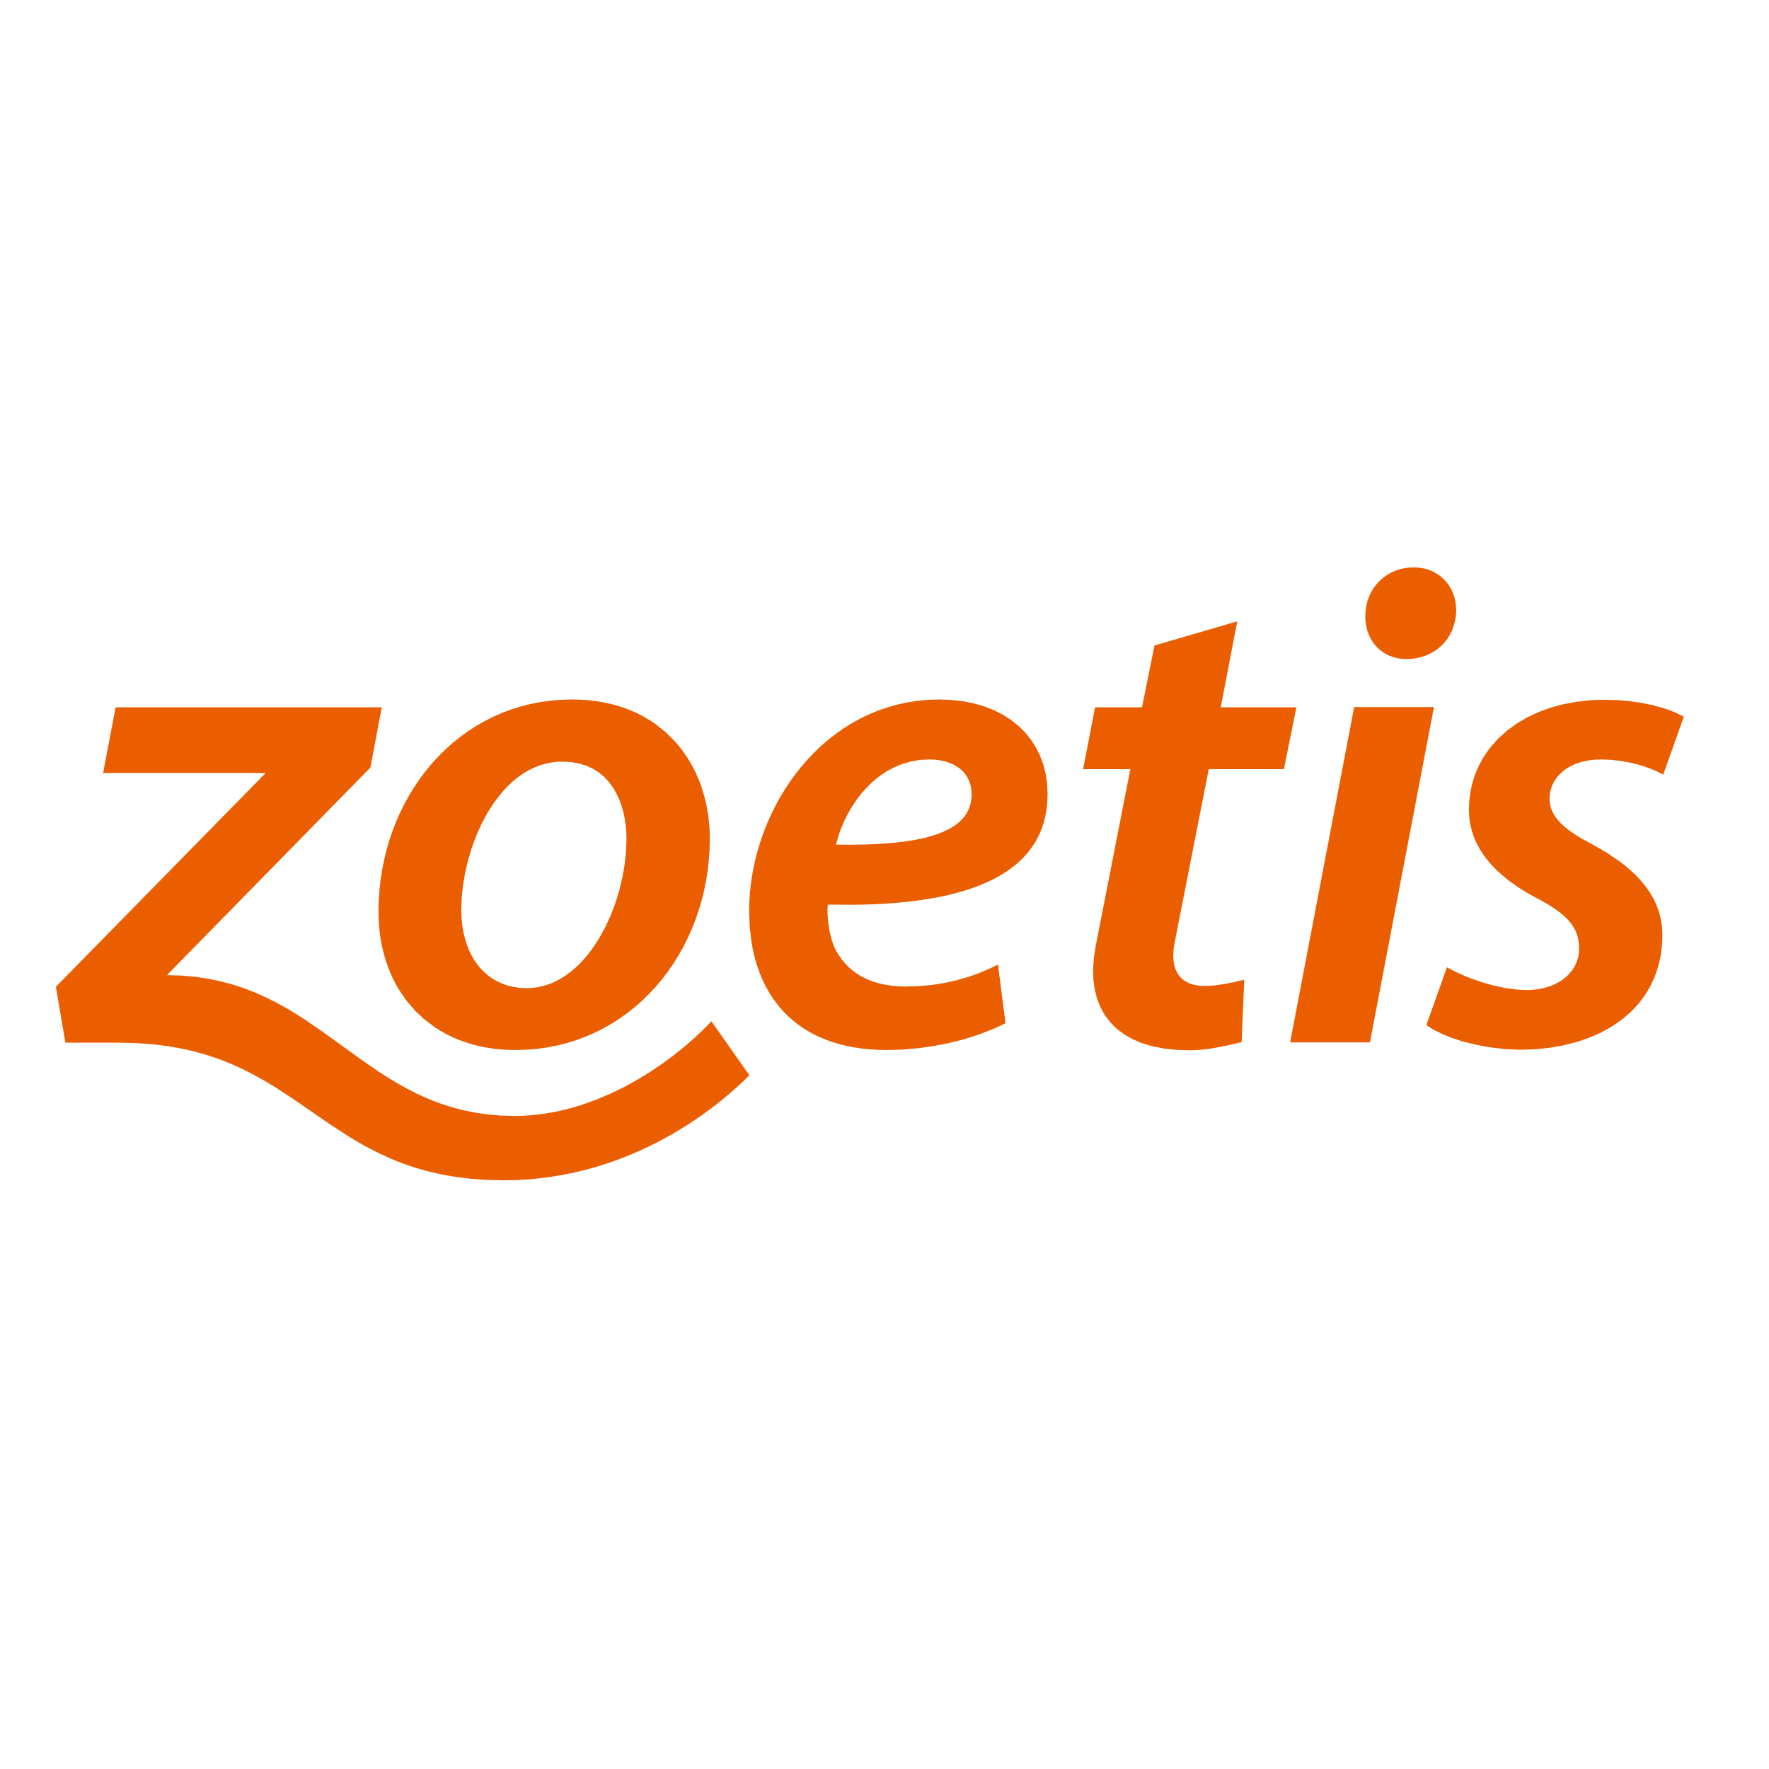





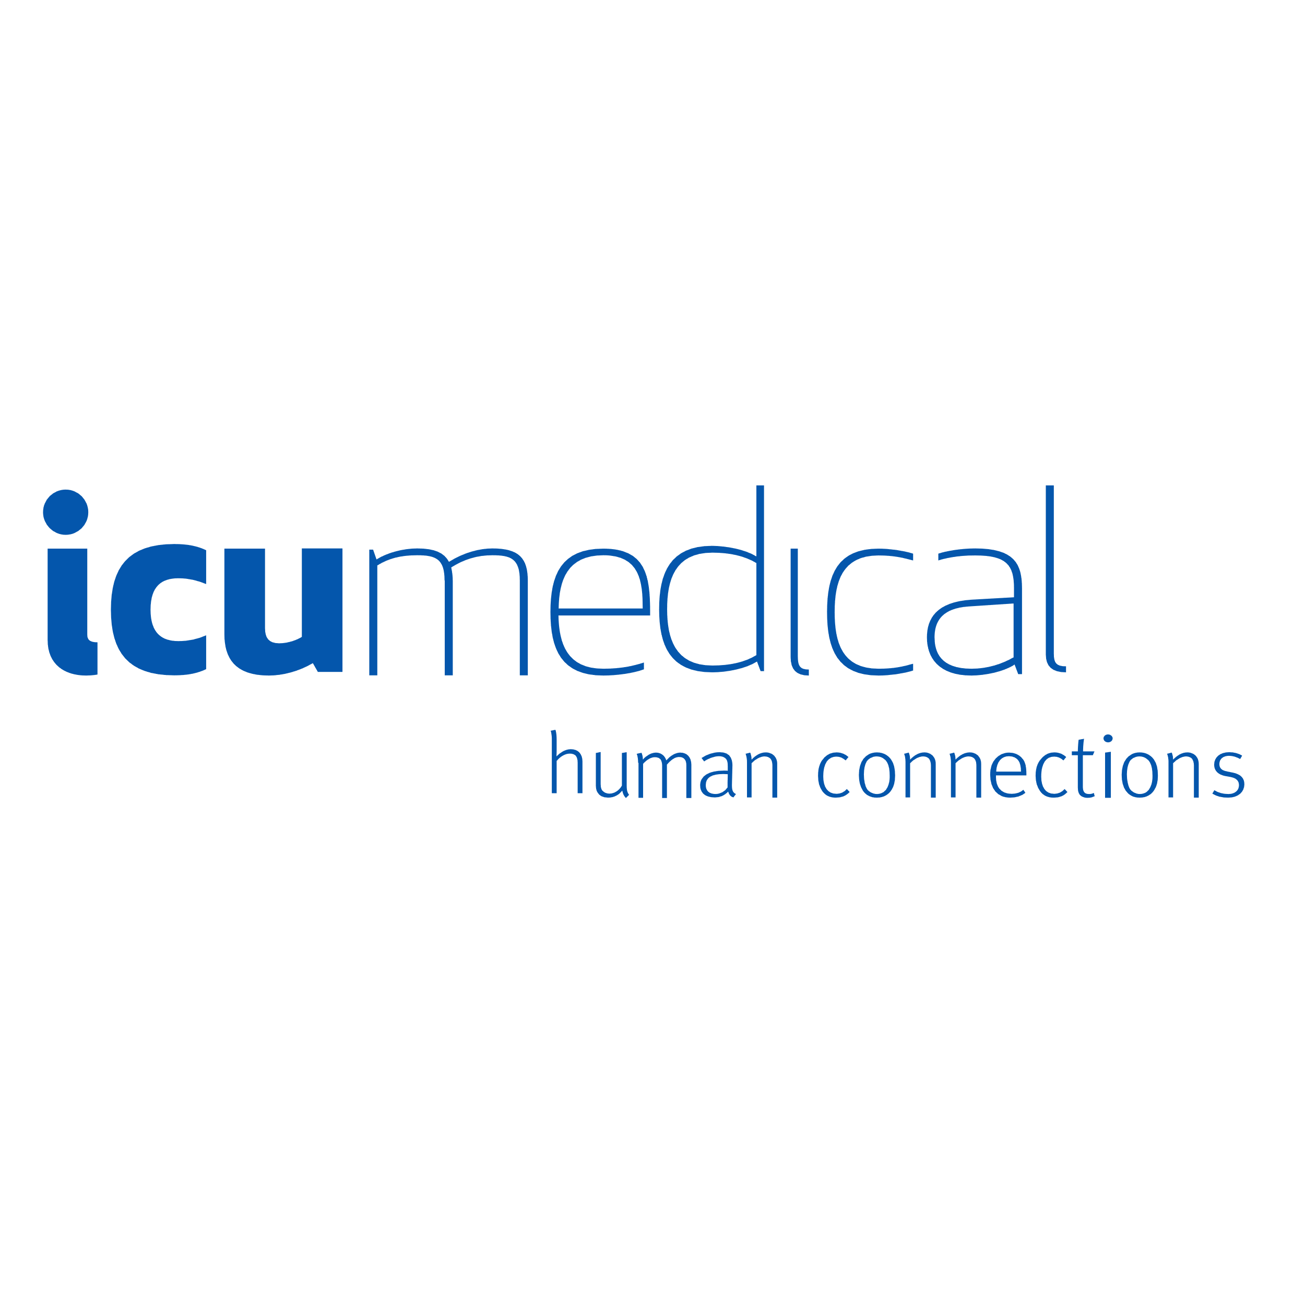

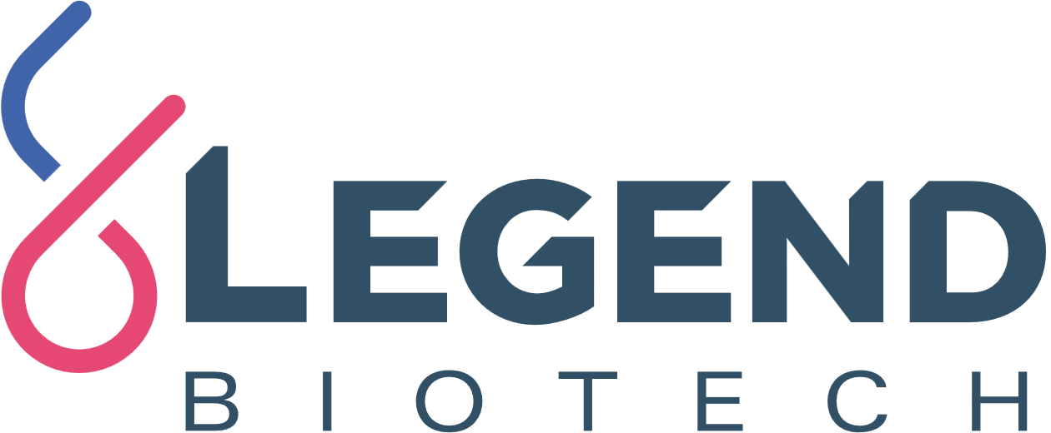
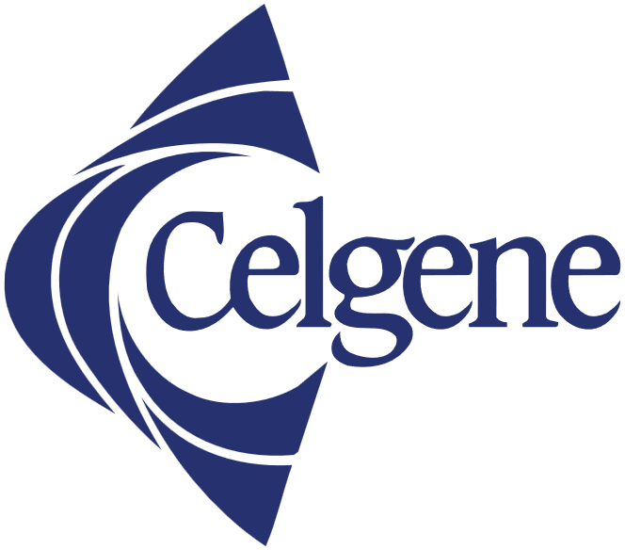



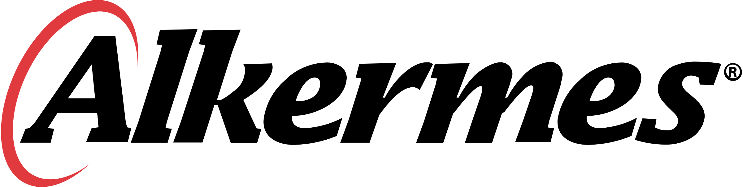


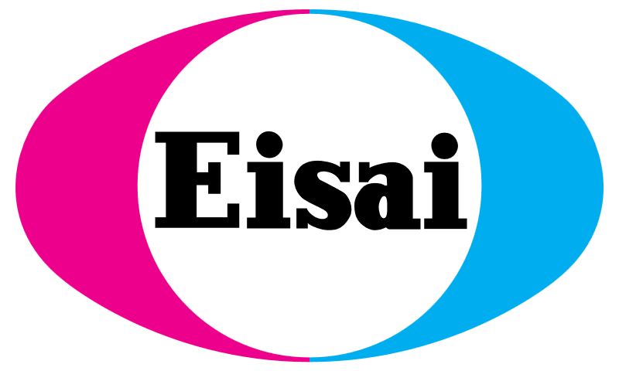


Life sciences leaders use ValGenesis VLMS …
Biotechnology
Pharmaceuticals
MedTech
Notes:
There are a lot of great stories behind these logos.
[[[ MATCH A LOGO WITH ONE THAT’S CLOSE TO YOUR CUSTOMER ]]]
Let’s focus on Bayer … customer for XX years, now grown to XXX.
Or Roche and Genetech … first-mover, adopter of e-logbook and CSV …
Dexcom … using us to run manufacturing equipment and the custom software that runs on that equipment
Cytiva …

Slide 9
… and see real business results
Biotechnology
Pharmaceuticals
MedTech
We can perform seamless validations across the globe with quick turnaround.
We reduced the validation cycle time by over 50%.
ValGenesis VLMS has tremendously reduced manual work and improved compliance through system-driven interlocks.
We eliminated human errors and removed 50% from the validation cycle time.
Now it takes 90% less time to complete testing activities. 40 audits resulted in zero audit findings on the validation records.
Validation related observations dropped 90%
after implementation.
Notes:
ANOTHER OPPORTUNITY TI TELL ANOTHER CUSTOMER SUCCESS STORY

Slide 10
Our employees don’t want to push paper. They want to change our world and transform medicine. We want to make sure they have the tools they need to do it.
Jeff Masten
COO
Theragent
Notes:
OPTIONAL SLIDE.
You saw our logo slide: some of the biggest life sciences companies are our customers. But this is one of my favorite quotes. Theragent is a startup CDMO in California. When we interviewed them for our case study, their COO Jeff Masten just nailed it.
“Our employees don’t want to push paper. They want to change our world and transform medicine. We want to make sure they have the tools they need to do it.”
Why do we do what we do? To help every life sciences company deliver life-saving products faster, safer and more cost-effectively than ever.

Slide 11
Up to 30%
of a typical project budget is allocated to validation
“Testing and validation processes are a vital part of all steps of the system engineering V-model [and] account for 20 to 30 percent of development costs.”
SOURCE: McKinsey.com

Slide 12



What does a traditional validation process look like?
Laborious
Time-consuming
Risk-uncertain
Tedious objective evidence
Manual Excel-based RTMs
Templates difficult to enforce
Email collaboration
Documents get stuck
Wet ink signatures
Printing and scanning
Paper archives
Waiting for approvals
Walking documents around
Non-standard forms
Manual version control
Inspection, audit panic
No easy data analysis
Process blindness
Notes:
These are just some of the common pain points as they’re described by our customers.
Customize this based on pain points coming from discovery call. Relate this to what the customer has already told us.
TO prospect: does this make sense to you? Does this look familiar? Would you add things to this list?

Slide 13
What if?
The validation lifecycle was digitized into a single, purpose-built, risk-based application?

Slide 14

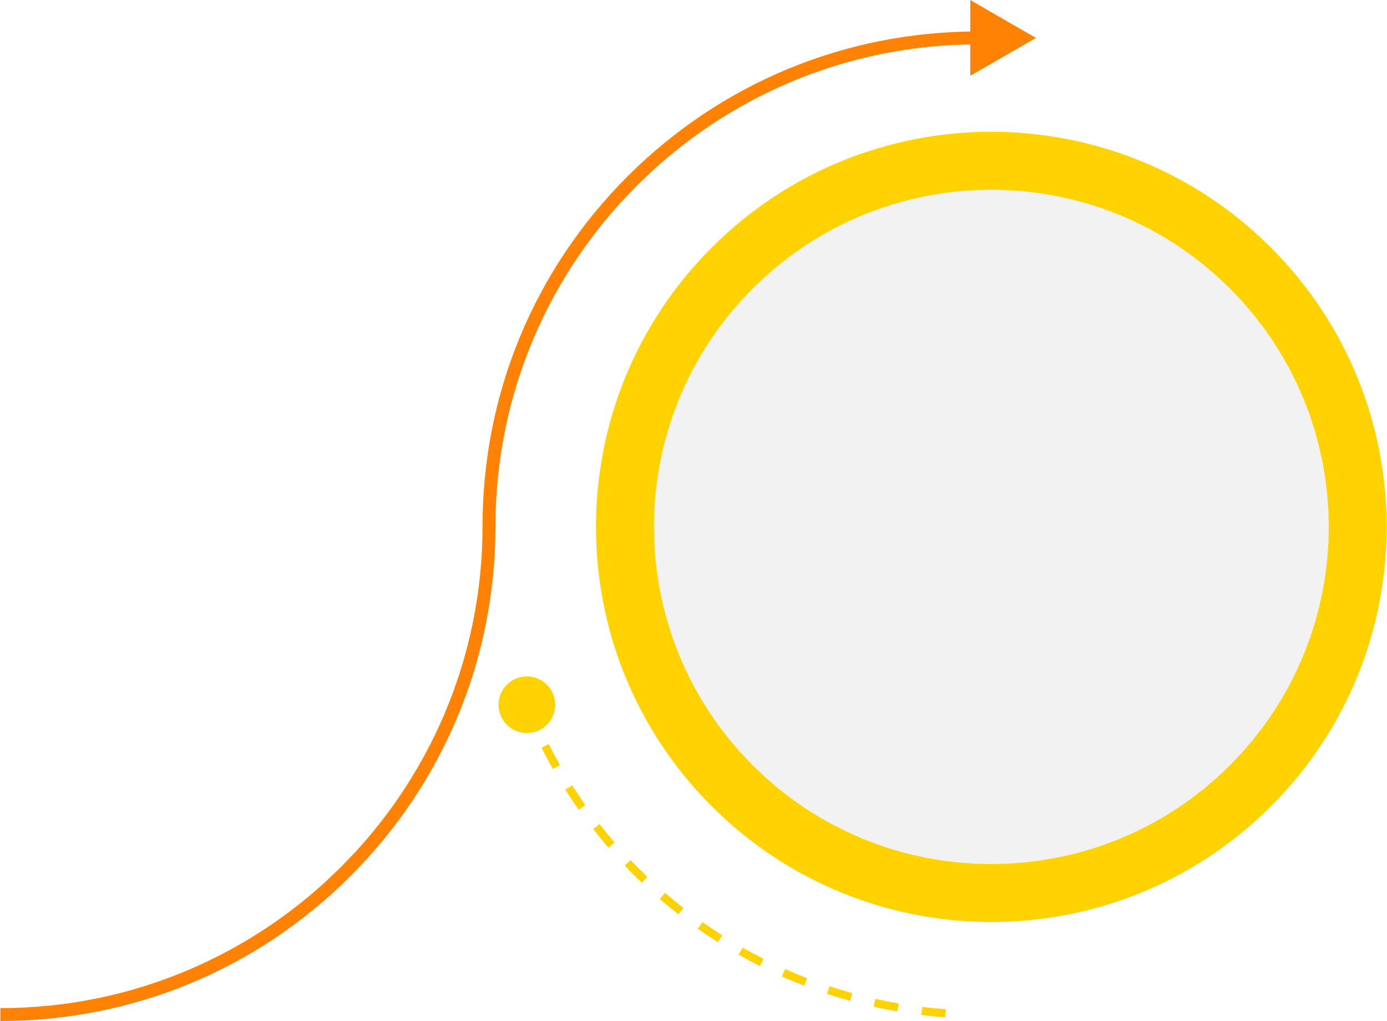


Your entire GxP organization benefits
Risk-Based
Data Integrity
Natively Digital
54% Faster
Notes:
CLICK: Risk-Based
First of all, and most importantly, risk is assessed and managed upfront at the requirement level. Before execution. This promotes critical thinking and is foundational to adopting new guidance like CSA and GAMP 5. It also contributes to significantly less documentation. By focusing on only high-risk requirements, you can easily reduce unnecessary documentation by 60% or more.
CLICK: Data Integrity
By delivering data integrity that meets all the demands of ALCOA+, you’ll strengthened your audit-readiness like never before. In fact, prepping for audits and inspections takes literal minutes. And because it’s digital and organized, inspectors love it. There is a reason that the FDA loves our VLMS.
CLICK: Natively Digital
Everyone talks about digital transformation. Going paperless is one thing. We can all use Excel and scan documents into a DMS. But our VLMS is a purpose-built application that starts digital and ends digital with no compromise, from requirement through inspection. Electronic signatures. Remote collaboration. Mobile capability. Remove silos between Office docs, DMSs and QMSs.
CLICK: 54% Faster
This isn’t a made-up statistic. This is based on real ROI studies of our customers. In fact, across key parts of the validation lifecycle like traceability matrices, efficiency improves by well over 80%. Bottom line: when you cut time and cost in half, you’re getting to market faster with product. And that’s what it’s about.

Slide 15
Enabling the bind functionality and global template management has helped us make tremendous strides toward standardization and harmonization. It has reduced the overall authoring time of deliverables by 30-70%.
Sathish Kumar Shanmugam
IT Product Manager
Roche
Notes:
Bind functionality does XXXX, and it’s something our competition lacks.

Slide 16
Let’s dive deeper
A brief view of VLMS functionality

Slide 17
ValGenesis VLMS: end-to-end digital validation lifecycle management
Validation Processes
CQV
CSV / CSA
Equipment
&
Instruments
Process
Method
Cleaning
Key Validation Functionality
System
Assessment
Validation
Planner
Requirement
Management
Risk
Assessment
Traceability
Matrices
Electronic
Execution
Risk-Based
Requirements
Deviation / Exception
Handling
Periodic Reviews
& Re-validation
Protocol
Authoring
API Integration
Multitenant
Offline Mode
Multilingual
Multisite
KPI Dashboards
No Code Config

Slide 18
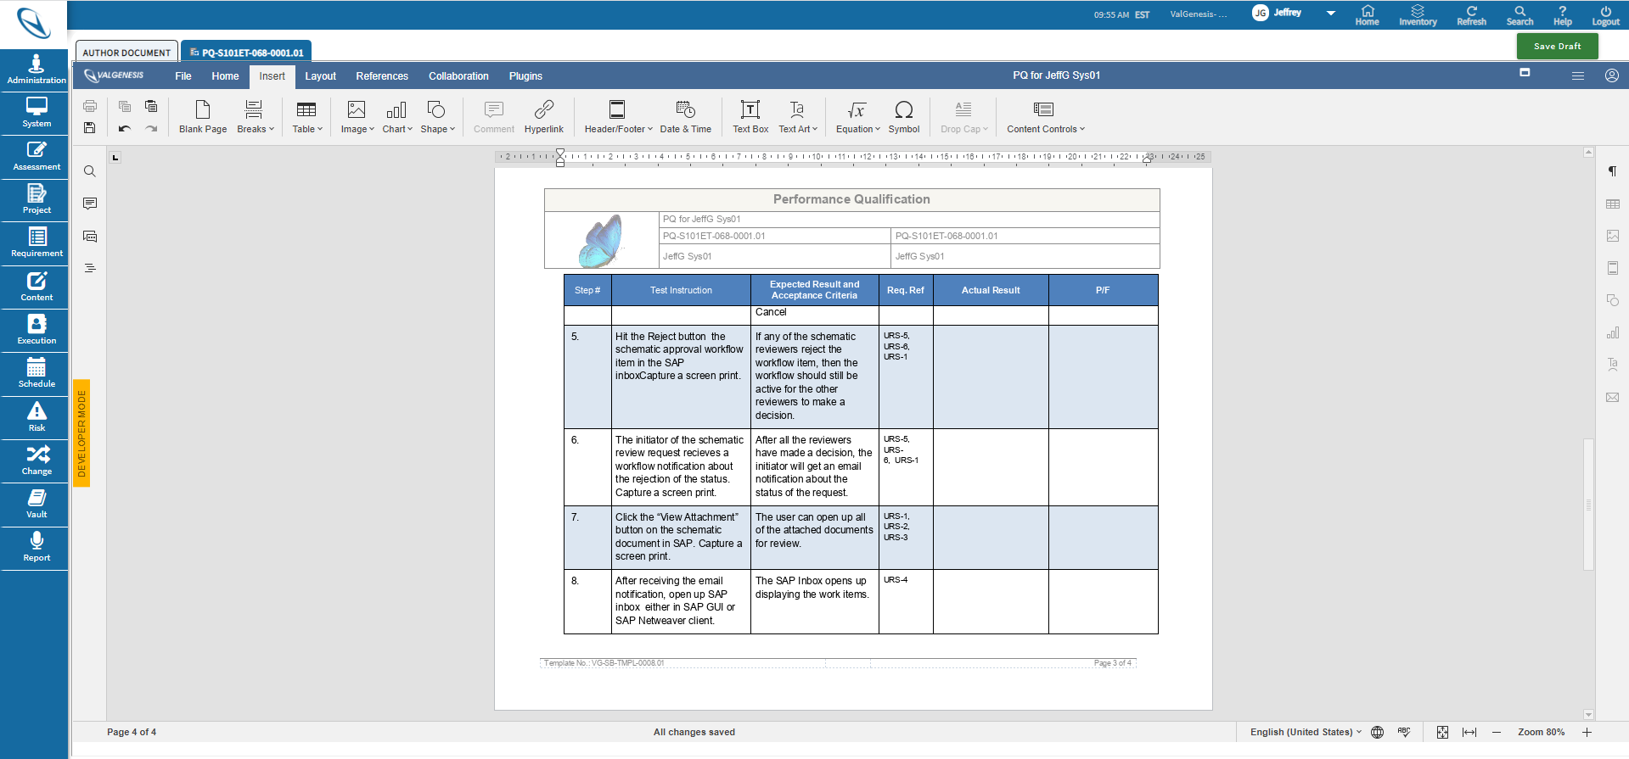
Flexible authoring
Reusable content
Decision trees
Document binding
Edit template while authoring
Embedded DB tagging
Version control
Notes:
Authoring:
Leverage Reusable content and/or decision trees help to automatically generate applicable content
Risk based authoring with enforced decision trees to ensure proper level of validation to meet regulatory compliance (i.e. GAMP 5)
Binding documents for like entities (equip or systems). Any changes to parent are reflected in all child documents.
No need to call in the consultants if you need to edit the template, VLMS allows speedy edits and approvals within the system
Utilize embedded db tags to pull information directly from the db, eliminating human/transposition/cut & paste errors.
Version Control logic maintains continuity and historical lineage of the document lifecyle…keeps your auditors happy!

Slide 19
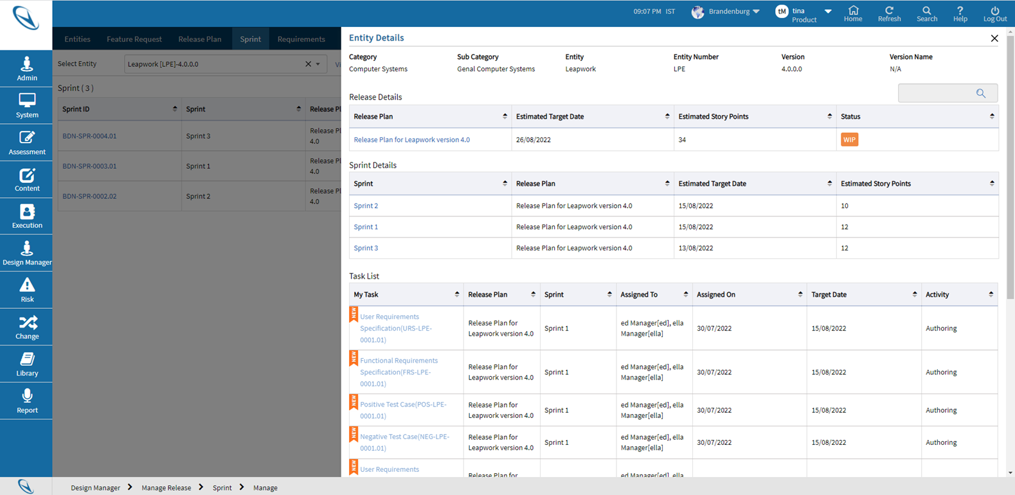
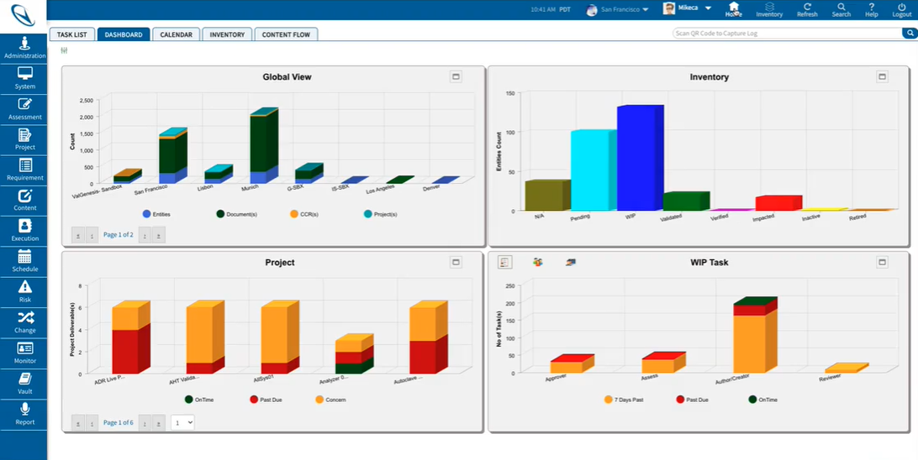
Risk-based requirements for CSA and agile
Assess risk at the requirement level
Reduce unnecessary over-testing by 80%
CSV and CSA exist in same platform
Utilize standard or Agile processes
Support ad hoc, scripted and any testing type
Notes:
ValGenesis VLMS is CSA ready out of the box. You can support critical thinking with risk-assessment at the requirement level, enabling you to focus on validating higher risk requirements.
In fact, you can run CSV and CSA processes in the same platform.
[[[ IF THE OPPORTUNITY IS NOT CSA, STILL EMPHASIZE RISK-BASED REQUIREMENTS ]]]

Slide 20
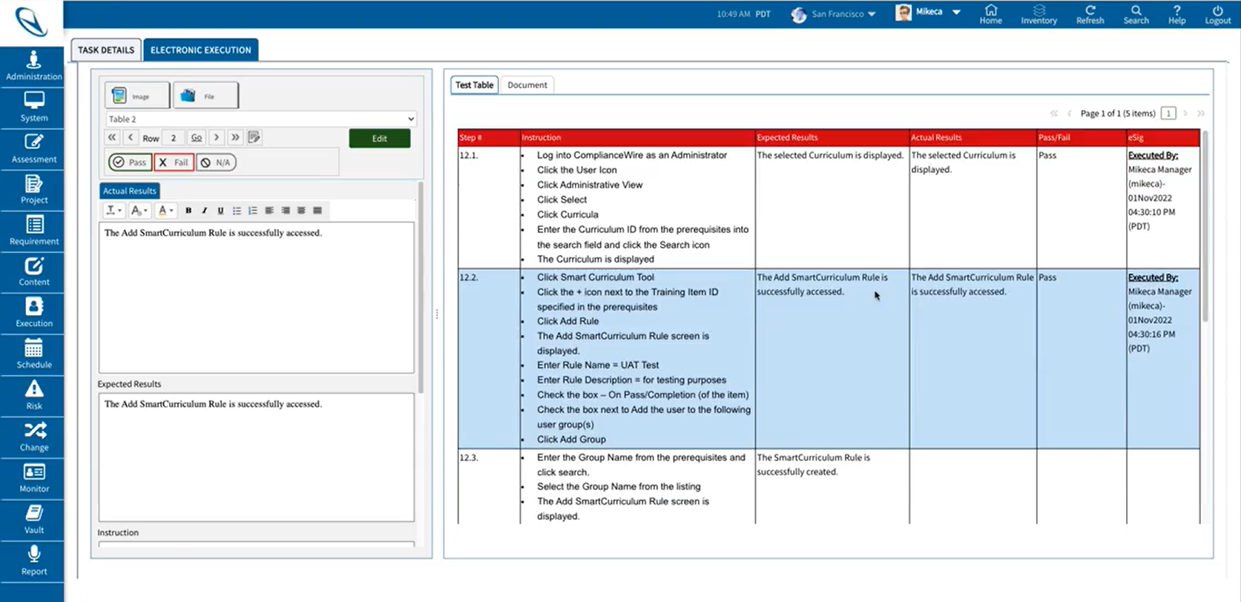
Intuitive execution
Capture objective evidence in the document
Electronic signatures
Immutable and time stamped
Deviation management
Set it and Forget it scheduling
Notes:
Execution:
Easier to capture and manage objective evidence (such as screen shots, screen snips, photos, attachments) directly into the document without having to print/scan evidence and manually tag
Stay Part 11 compliant without constant log ins to e-Sign each step. Exceptions allowed as required and established/controlled by you.
All objective evidence is automatically appended into the PDF document upon approval, so printed documents are Part 11 compliant.
Easily review and manage deviations since all evidence is linked to the deviation workflow to properly assess the failure.
No more manual tracking of schedules, set the schedule and tasks will be auto generated with notifications

Slide 21
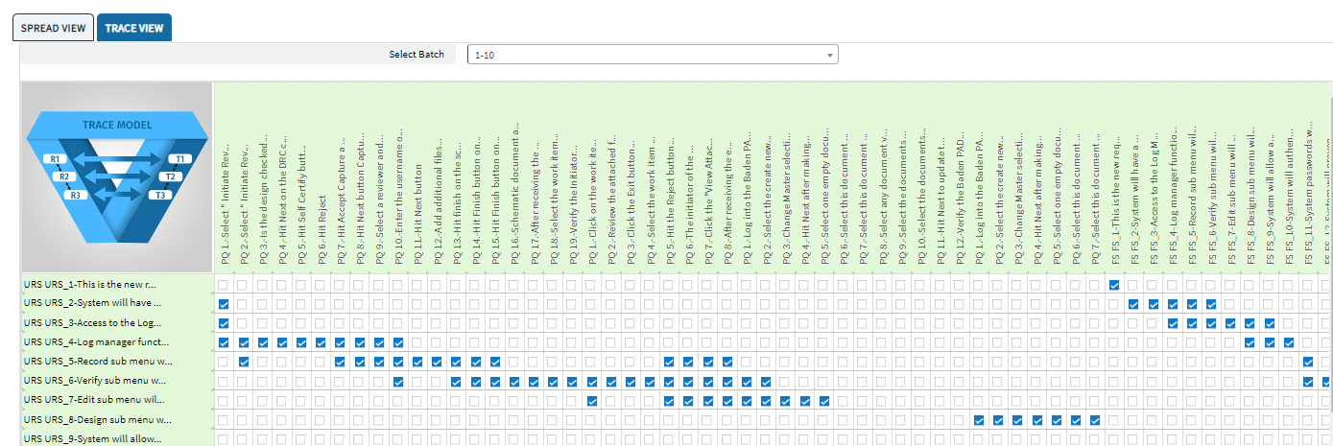
Dynamic traceability matrices
Patented, impact-of-change algorithms
Auto generated in real time during authoring
Updated in real-time during execution
Identify deviation impact on all requirements
Understand and react to any impact of change
Notes:
Other vendors will talk about their trace matrices, but be sure to understand the VLMS difference
ValGenesis has the patent on impact of change trace matrices that ensure you can immediately visualize which protocols have been impacted by CCR’s and/or deviations.

Slide 22
Reporting and KPI dashboards
Create standard and ad-hoc reports
Instant visualization
Export easily

Slide 23


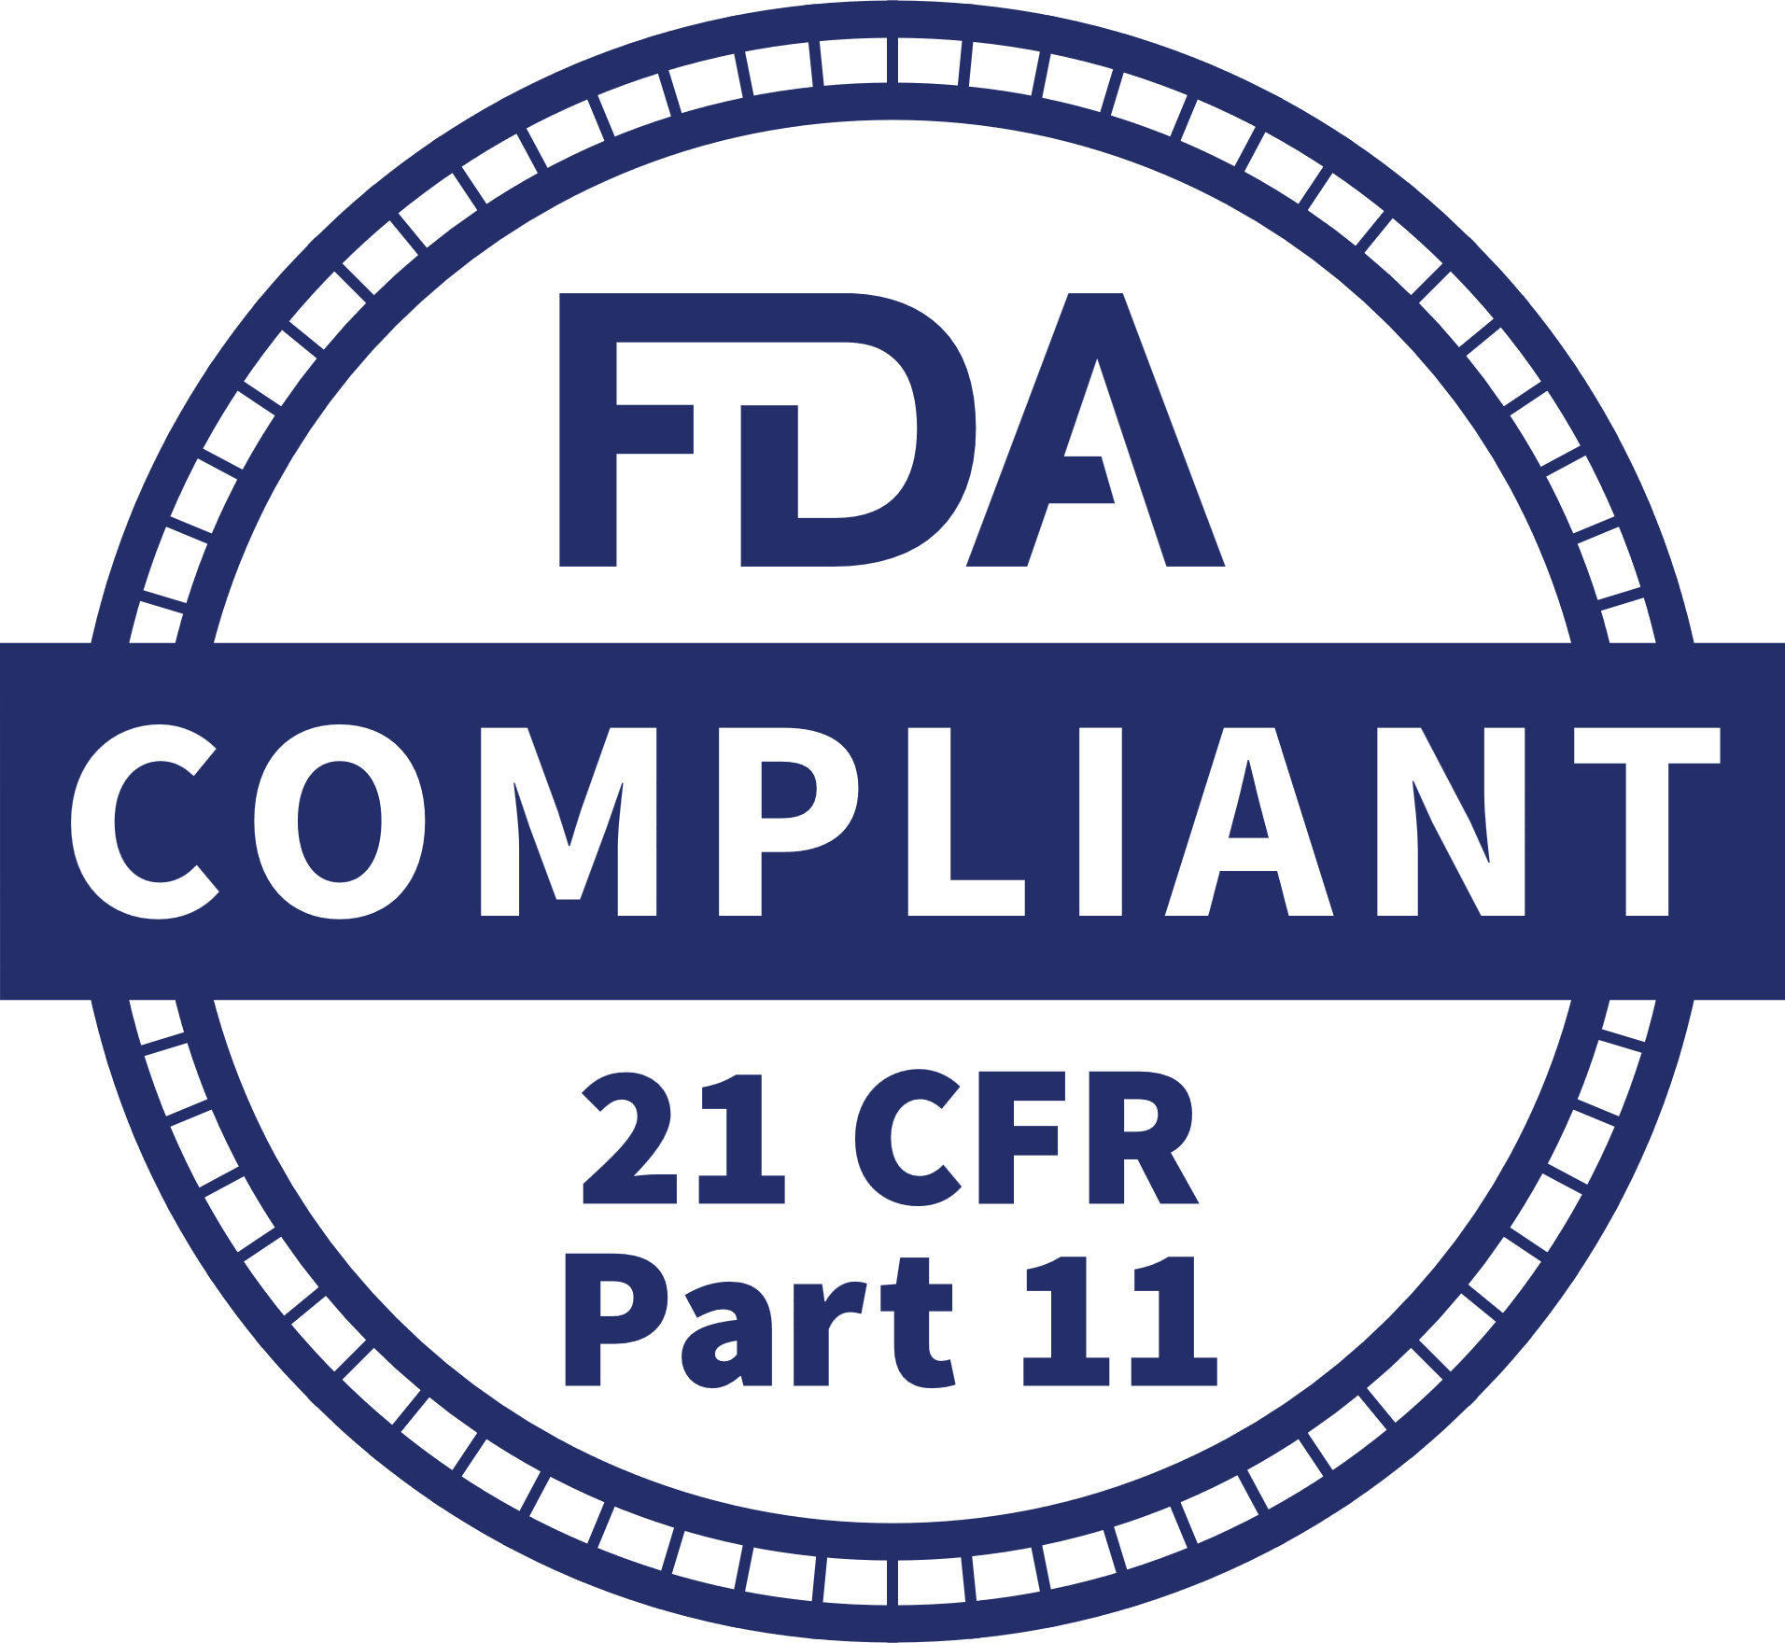
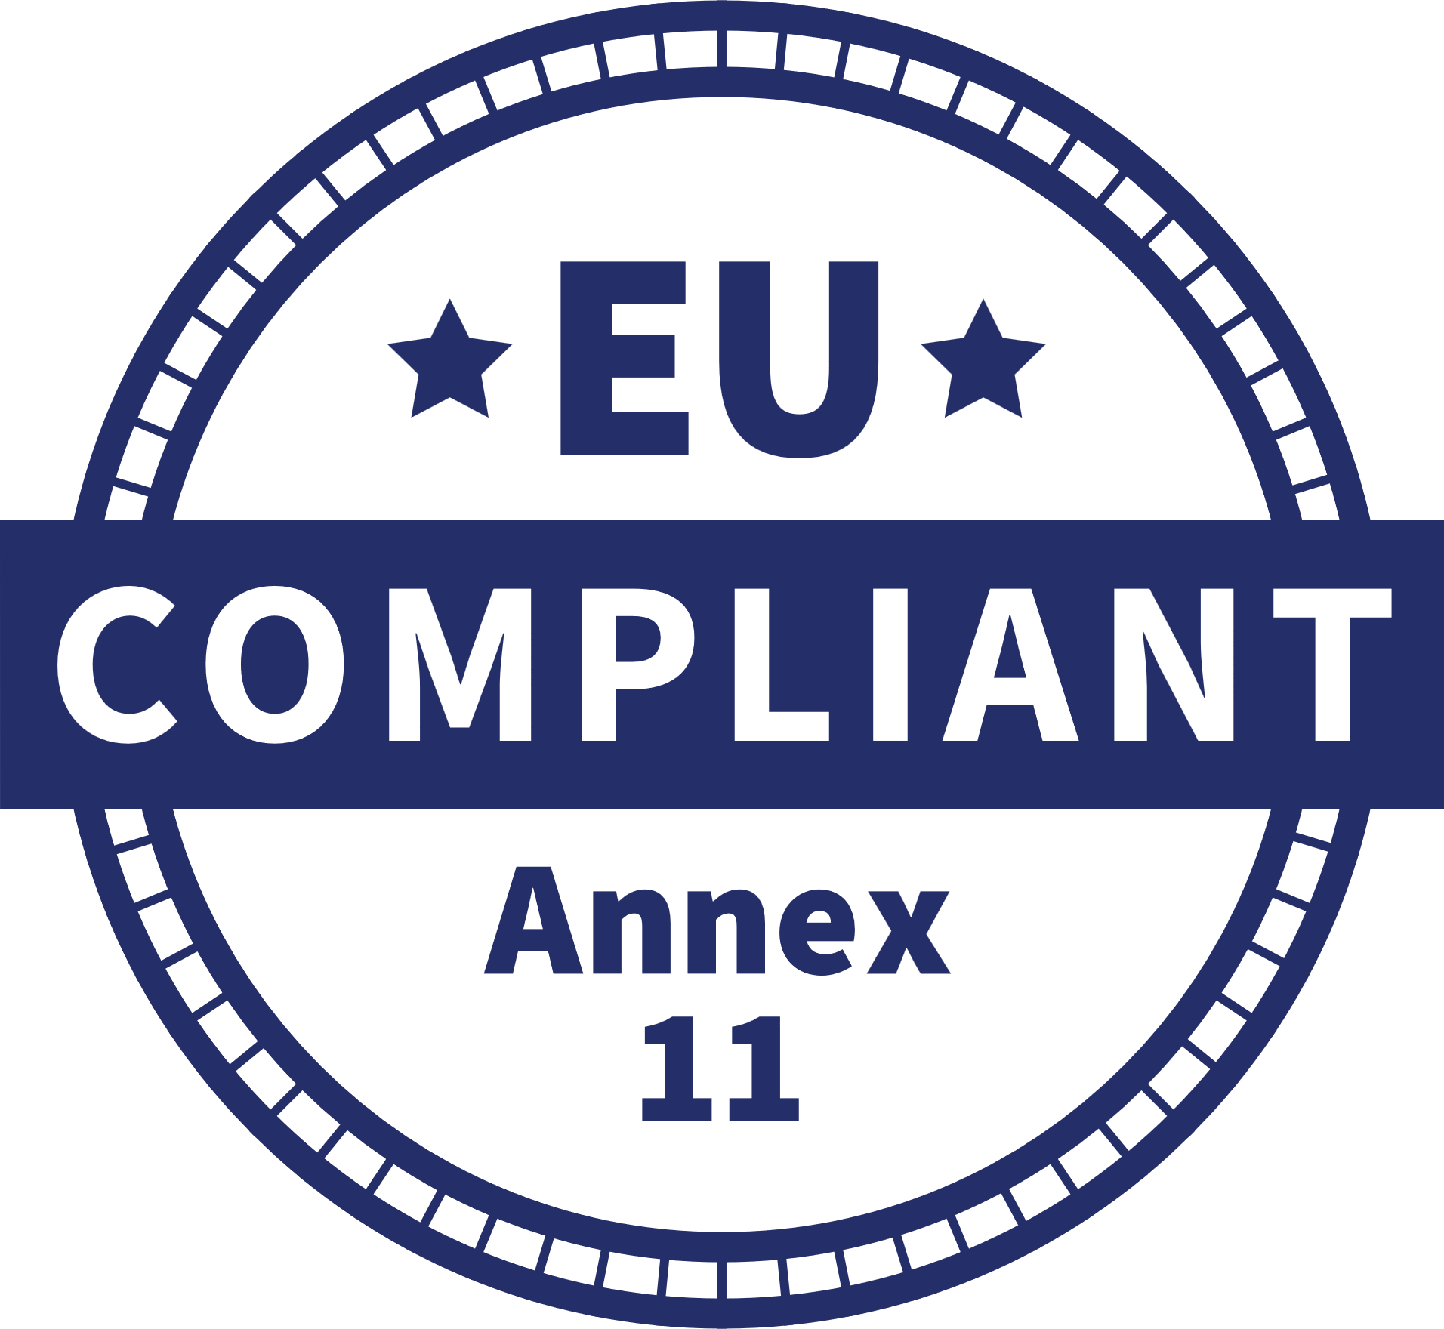
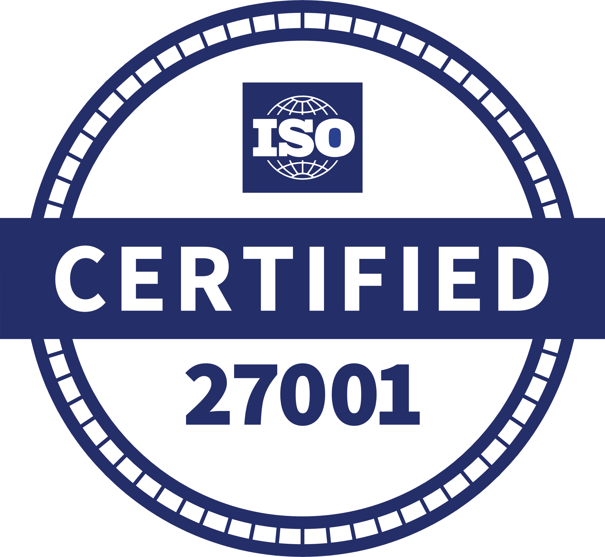
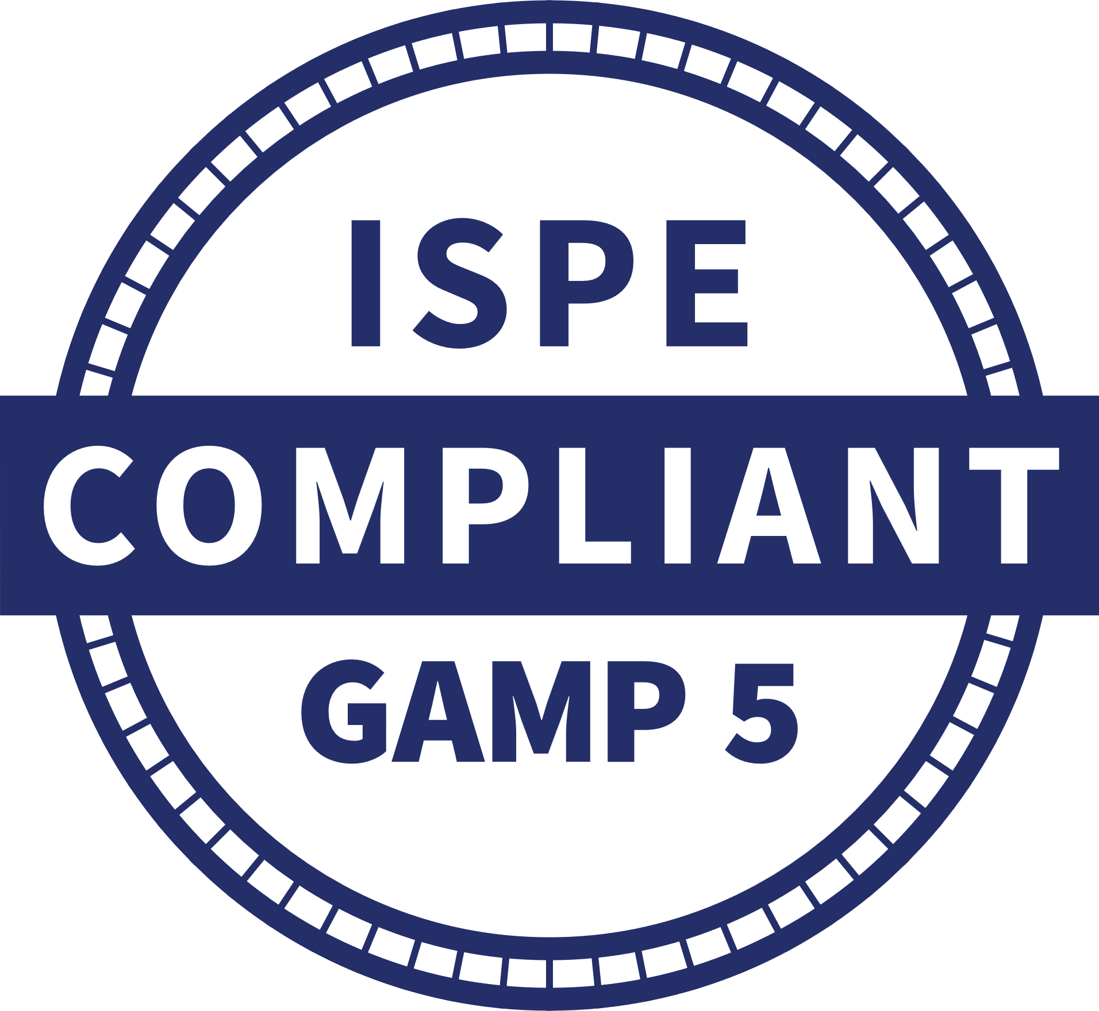
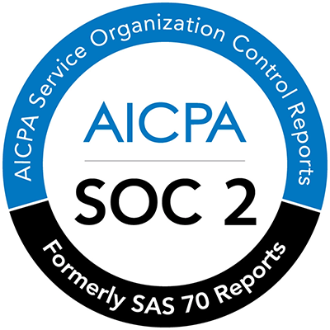

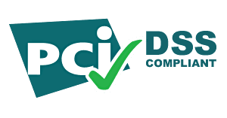
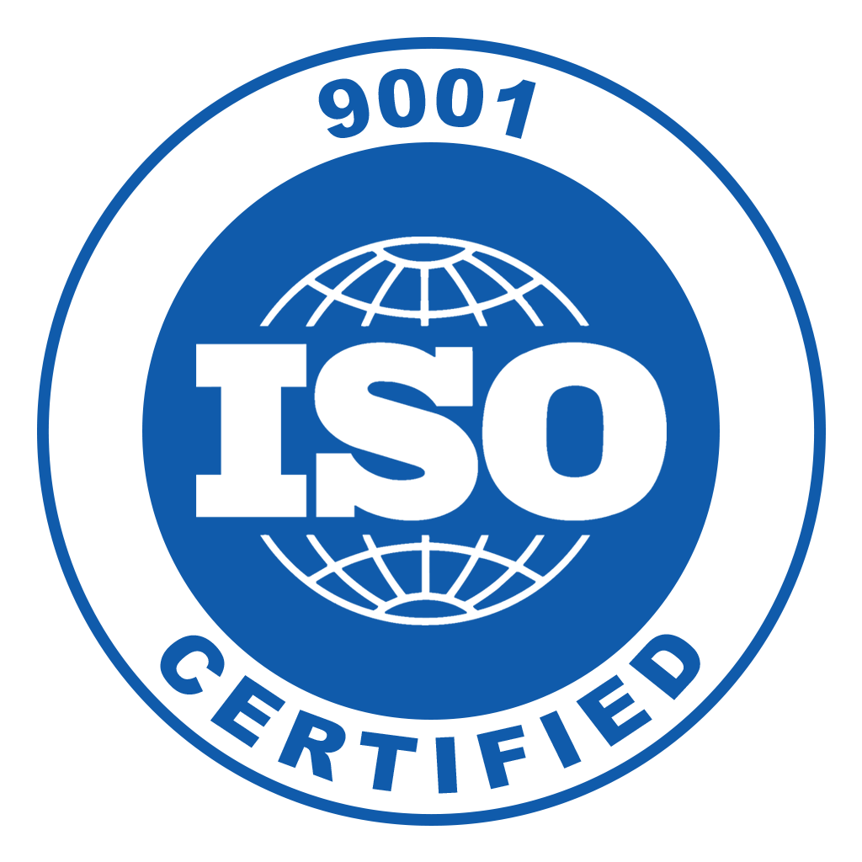
ValGenesis SaaS architecture
Europe
North
America
Fully validated with certificate
Secure cloud on Microsoft Azure
SaaS regional hosting of data
Active Directory/SSO
Role- and group-based privileges
India
North
America
India
Europe
Notes:
USA primary: North Central US (Illinois)
USA Secondary: South Central US (Texas)
EU Primary: West Europe (Netherlands)
EU Secondary: North Europe (Ireland)
APAC Primary: West India (Mumbai)
APAC Secondary: South India (Chennai)

Slide 24





VLMS Implementation Model
2 Weeks
5 Weeks
4 Weeks
7 Weeks
7 Weeks
Initiation
Kick-Off
System Specification
System Configuration
System Validation
Go-Live
Transition
Project strategy workshop
Create development instance
Project schedule
Validation planning
System overview sessions
User requirements identification
Business process identification
Train the trainer
Configuration workshops
Master data collection and training
Conference room pilot
System template development
Training material development
Creation of validation and production instances
Validation of the instances
Master data upload
End user training
Production release
Transfer to customer technical support
Project closure

Slide 25

Top ten reasons why customers select and grow the ValGenesis VLMS
#10
#9
#8
#7
#6
Company
stability and longevity
Mobile app
with offline support
Integration with validated API
Multisite and multilingual for global deployment
Real-time traceability matrices
#5
#4
#3
#2
#1
Defensible ALCOA+
data integrity
Agile-ready
Risk-based requirements and system assessment
CSA-ready, supports risk-based critical thinking
Single platform for validation, logbooks, cleaning and CPV
Notes:
#10: Company stability and longevity. We’ve been around for nearly two decades, have grown by double digits almost every year, and have earned the trust of the biggest names in life sciences. We’re backed by Morgan Stanley, profitable, and not going anywhere.
#9: Mobile app with offline support. Execute and approve the validation deliverables without network connections.
#8: Integration capability. Our validated API stack can interface with other GMP systems.
#7: Multisite and multilingual for global deployment. We can scale to support the largest implementations to enforce standardization at a global level.
#6: Real-time traceability matrices. These are dynamic and automatically generated, saving untold hours in labor and enabling teams to rapidly match requirements with tests.
#5: Defensible ALCOA+ data integrity. Electronic signatures, timestamps, and more automatically fulfil and exceed the data integrity requirements of documentation. And it’s all captured automatically.
#4. Agile ready. Support iterative methodologies and any type of testing, including ad hoc and scripted, to align validation with development cycle.
#3. Risk-based requirements and system assessment. The VLMS considers risk at every level, and also supports almost every risk assessment tool like FMEA, FTA, Decision tree, and much more.
#2. CSA ready. Support risk-based critical thinking and fulfil the requirements of CSA out of the box.
#1. Single platform for validation, logbooks, cleaning, CPV. A full-featured platform approach enables true digital transformation through our manufacturing intelligence approach.

Slide 26
Demo
With Emmanuel Cansino / Your SET Person

Slide 27
Thank you!
Presenter Name
Title
contact info

Slide 28
Interesting facts about the ValGenesis VLMS
Risk models are unlimited:
FMEA, RPN, Custom with multiple factors and derivatives
Risk is reported in the RTM at the Requirement and Test Step level
Risk outcomes can drive unlimited Frameworks which establish required and optional deliverables
Protocols and requirements can be automatically generated, powered by decision tree logic
Content types are unlimited:
URS, FRS, DS, SRS, SAT, UAT, IQ, OQ, PQ, IOPQ, VP, VSR, MVP, etc.
Test methodologies are unlimited:
positive, negative, boundary, security, black/grey/white box, performance, ad hoc, unscripted, exploratory
Unlimited Sites
VLMS was CSA ready before CSA guidance was released
VLMS was GAMP 5 E2 ready before release
Hyperlinks will take you to requirement details

Slide 29
How is validation transformed for people?
I don't have to worry about handwriting
ALCOA data integrity is automatic
My trace matrix is automated
Screenshots captured with a mouse click
Audit, data, edit trails are automatic
QA is happy because I use the correct template every time
I don't have to walk around trying to get signatures or find documents
If a person is out-of-office, no big deal. I can transfer tasks
My supervisor can see progress in real-time without even having to ask
I can raise the quality and compliance bar
My hand and wrist isn't sore from writing
Electronic execution is a game-changer
Documents will always route to the right person or group
My entire validation package is at my fingertips
Defending my validation has never been easier
I don't have to jump to different systems to handle deviations or manage my documents
Keyword searches help me find things throughout history
I won't ever miss a required deliverable
I can reuse deliverables
I can automatically generate protocol content
I can have my colleagues help me no matter where they are in the world

Slide 30
How is validation transformed for the company?
We're always in a state of inspection readiness
We can focus on real high risk and not waste time on low risk (risk-based & least burdensome)
We can deploy CSA just my implementing this technology
We can perform follow-the-sun validation (365/24/7)
We can leverage validation deliverables from internal and external sources
We can achieve 100% paperless
We can progress to Pharma 4.0
We can integrate with other systems to share data and functionality
We can eliminate frustration experienced between QA, Validation, PMO, and the business
We won't lose documents
We are assured the correct document is accessed
We can enforce processes with technical controls
We can streamline Standard Operating Procedures (SOPs)
We can manage all our validation in one place
We don't need different systems for deviation management, risk management, document management, etc.
We will save time and money while improving Quality

Slide 31
Our Vision
To become the de facto standard for manufacturing intelligence for life sciences companies

Slide 32
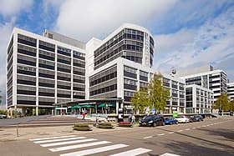

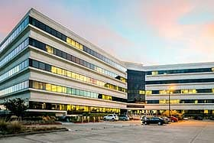
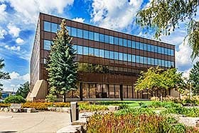
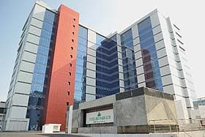

About the company
Schiphol
Industry pioneer of digital validation
Product-focused, patented technology​
Expanding platform portfolio​
98+% renewal rate
Profitable, backed by Morgan Stanley
YoY growth over past 10 years
25+ global certified partners
550+ employees across 4 continents
Tampa
Santa Clara
Toronto
Chennai
Bengaluru
Lisbon

Slide 33
ValGenesis VLMS has tremendously reduced manual work. It is contemporaneous, easy to execute, and we can quickly access executed documents. More importantly, it has improved compliance through system-driven interlocks.
ValGenesis customer

Slide 34
How does digitized validation transform organizations?
Before |  | After
All requirements are tested as high risk, wasting time and creating over-documentation | → | Assess risk early and prioritize high risk requirements to remove 80% of over-testing
Misalignment with QA on correct templates creates frustration | → | Correct template is used every time and delivered consistently, streamlining QA
Handwritten evidence, unsecure Office documents, and paper threaten data integrity | → | Every deliverable follows ALCOA++ data integrity principles
Preparing for audits takes days of manual data collation with risk of missing information | → | Preparing for audits takes minutes with all data automatically assembled for reviewers
Validation is time-consuming and stops frequently based on team availability | → | Collaborate virtually in a single application and perform follow-the-sun validation (365/24/7)
Notes:
Break this into customer-specific stories
OR solution-specific library

Slide 35
Equipment Lifecyle in the ValGenesis platform
iRisk: Risk Lifecycle Management
VLMS
Validation Lifecycle Management
Process Manager
Cleaning and Process Validation
e-Logbook
e-Logbook and eBR
Process Insight
01
Commissioning
05
Cleaning Validation
Equipment Design + Grouping
09
Cleaning Batch Records
Cleaning Validation – Stage 3
13
Continuous Process Verification
Process Validation – Stage 3
02
Qualification
06
Cleaning Validation
PPQ
10
Electronic Batch Records
Process Validation – Stage 3
14
APQR
03
Periodic Review and
Re Qualification
07
Process Validation
Equipment + Facility Readiness
11
Digital Logbook
15
Quality Metrics
04
Change Impact Assessment
08
Process Validation
PPQ
12
Knowledge Management
16
Predictive Maintenance
(AI/ML)
VConnect: Direct Data Access from Equipment and Instruments
Real-time status of facility and equipment cleaning and usage during production
Holistic view of the equipment lifecycle and overall equipment efficiency (OEE)
Predictive maintenance for equipment

Slide 36
Product Lifecyle in the ValGenesis platform
iRisk: Risk Lifecycle Management
Process Manager
Cleaning and Process
Validation
Process Mngr + VLMS
Cleaning and Process Validation
e-Logbook
e-Logbook and eBR
Process Insight
01
Cleaning Validation
Studies (Stage 1)
05
Cleaning Validation
Equipment Design + Grouping
09
Cleaning Batch Records
Cleaning Validation – Stage 3
13
Continuous Process Verification
Process Validation – Stage 3
02
Equipment and Product
Grouping for CV
06
Cleaning Validation
PPQ
10
Electronic Batch Records
Process Validation – Stage 3
14
APQR
03
QbD for Process Validation
(Stage 1)
07
Process Validation
Equipment + Facility Readiness
11
Digital Logbook
15
Quality Metrics
04
Process Design, Scaleup and
Formulation Studies for PV
08
Process Validation
PPQ
12
Knowledge Management
16
Predictive Maintenance
(AI/ML)
ValGenesis Gateway: API Layer for LIMS, SAP and QMS Systems
Realtime Status of Product Lifecycle
Eliminate Batch Failures
Predictive Maintenance

Slide 37
A real ROI of 54%
Backed by real customer efficiency studies.
Notes:
OPTIONAL.
Partnering with our customers after deployment, we studied the efficiency gains of ValGenesis VLMS across all the tasks related to validation plans, authoring, executing, maintaining trace matrices, performing risk assessments, maintaining periodic review and revalidation schedules, and more.
The digitization, automation, and control delivered by VLMS benefits every aspect of the validation lifecycle. Boiled down? An ROI of 54%.
This is the average. The more features of VLMS that were used, the higher the efficiency.
Imagine: doubling your validation productivity.

Slide 38


Superior business
results today
Life-changing patient results tomorrow
Notes:
OPTIONAL SLIDE.
These features and benefits, are nice, but what does it ultimately mean?
What’s the real advantage?...

