Slide 2
VLMS
Customer Name
Kevin Potts

Slide 3
About ValGenesis

Slide 4

About us
Industry pioneer of digital validation
Product-focused, patented technology​
Comprehensive platform approach​
98+% customer renewal rate
YoY growth for 10+ years
50+ global certified partners
Staff across 4 continents
Our Mission
ValGenesis empowers life sciences companies to improve quality of life by accelerating the delivery of consistent, safe products.
Notes:
Our mission is simple: we empower life sciences companies to deliver of consistent, safe products. This is why we get up in the morning. This is why we’re talking today.
We’re the pioneer and leader of digital validation, but as you’ll see in a minute, our full lifecycle approach carries this mission and product innovation to all aspects of GxP.

Slide 5
Industry leadership by the numbers
1st
30
450+
18
To market
with a digitized
validation platform
Of the top 50 life
sciences companies
are customers
Sites using
ValGenesis
products
Years of
growth
Notes:
Just a few numbers that matter.
We were first to market with a digital validation solution.
That’s enabled us to win the trust of the world’s leading life sciences companies. Bayer. Roche. Otsuka. GSK. Philips and hundreds more.
In fact, many customers use multiple ValGenesis products across multiple sites and geographies. We’re currently deployed in more than 450 locations across the globe.
And nearly 20 years of growth speaks for itself.

Slide 6
The ValGenesis lifecycle approach
STAGE 1
R&D
STAGE 2
Qualification & Validation
STAGE 3
Commercial Operations
Risk
Assessment
Control Strategies
Validation
Technology
Transfer
Quality
Metrics +
APQR
Decommission
Design
CQV
PPQ
Change
Impact Assessment
Continuous Monitoring
ValGenesis iRisk
ValGenesis Validation Lifecycle Management
ValGenesis Process Insight
Process Manager
ValGenesis e-Logbook
Process Improvement Consulting Services
Notes:
ValGenesis assumes a lifecycle approach to our entire portfolio. Our offerings span all stages of GxP, supporting the many teams responsible for bringing your products safely to market.
Within R&D, our tools define the commercial manufacturing process, and enable you to critically evaluate and mitigate risk while designing robust control strategies.
Within Stage 2, we ensure the process is ready for commercialization via a holistic digital qualification and validation solution that spans equipment, computer systems, cleaning, and beyond.
And finally, in commercialization, we facilitate deep process control via best-in-class continuous process verification software.
Within our unified approach, your models, quality attributes, knowledgebase, documentation, protocols, and more are centralized into systems of record purpose-built for the complexities of your site.
Today, we’re talking about ValGenesis VLMS.

Slide 7














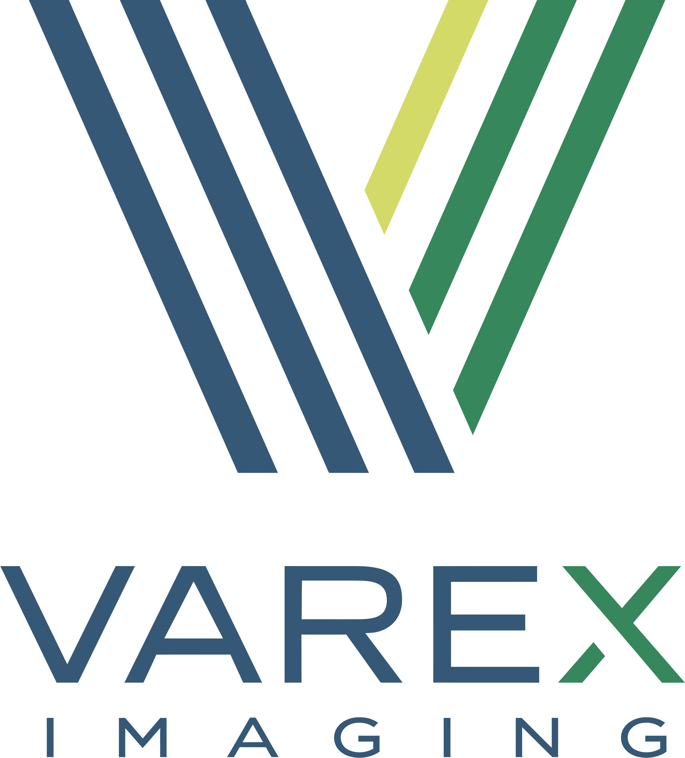







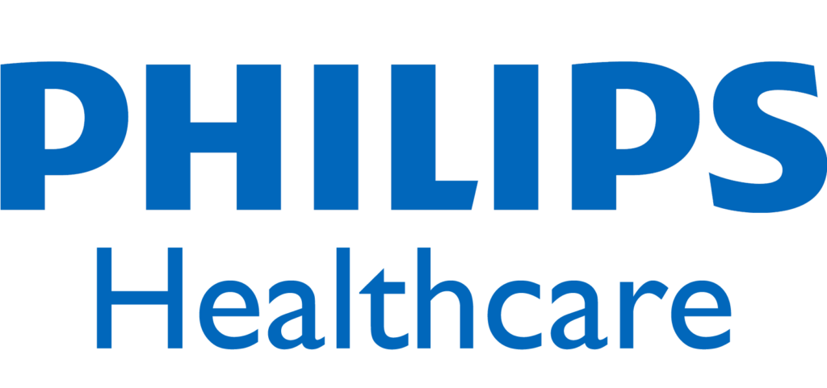
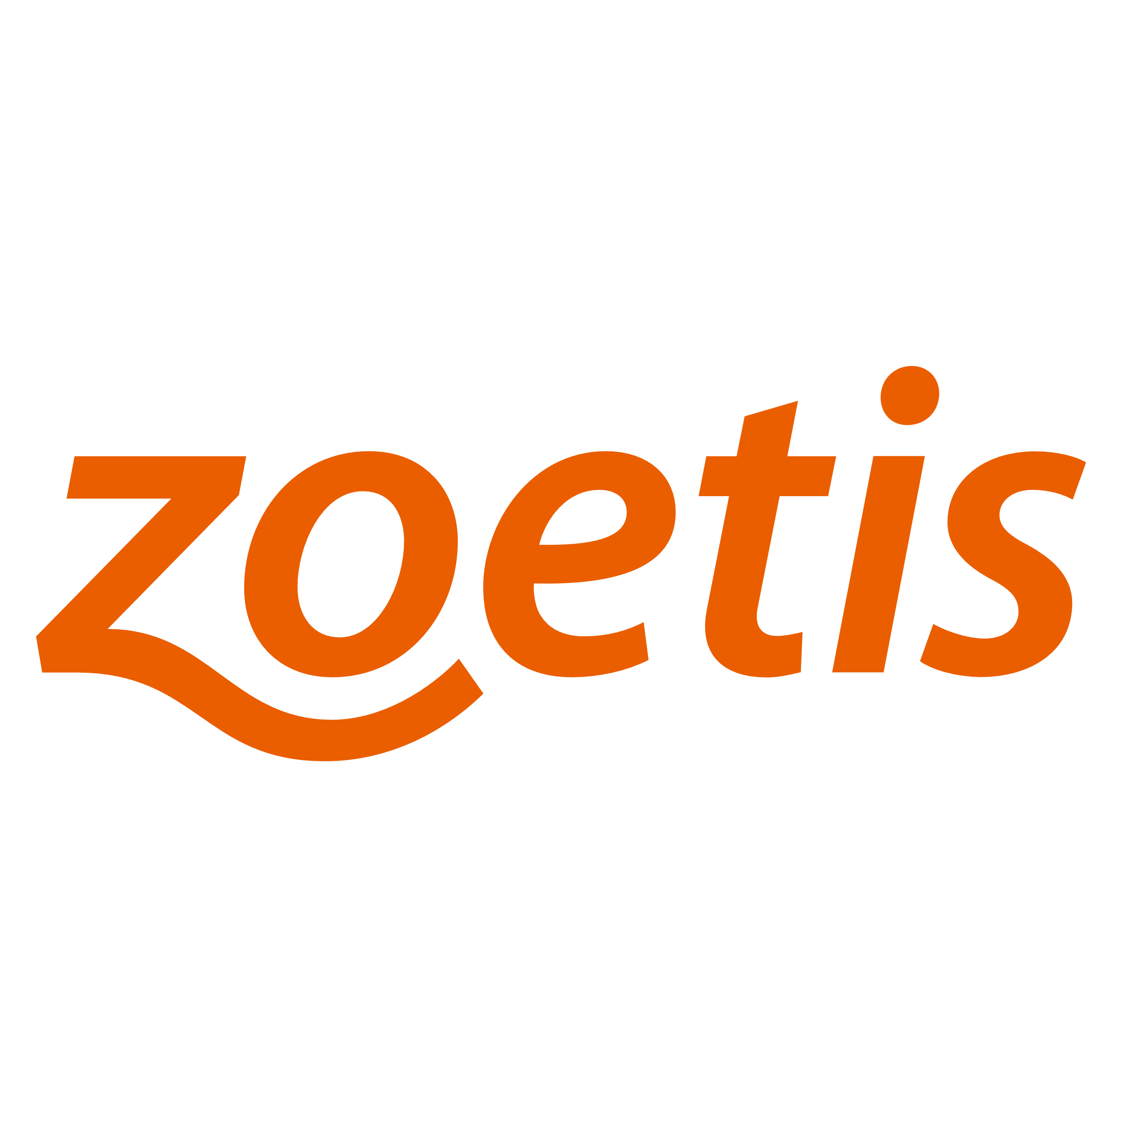





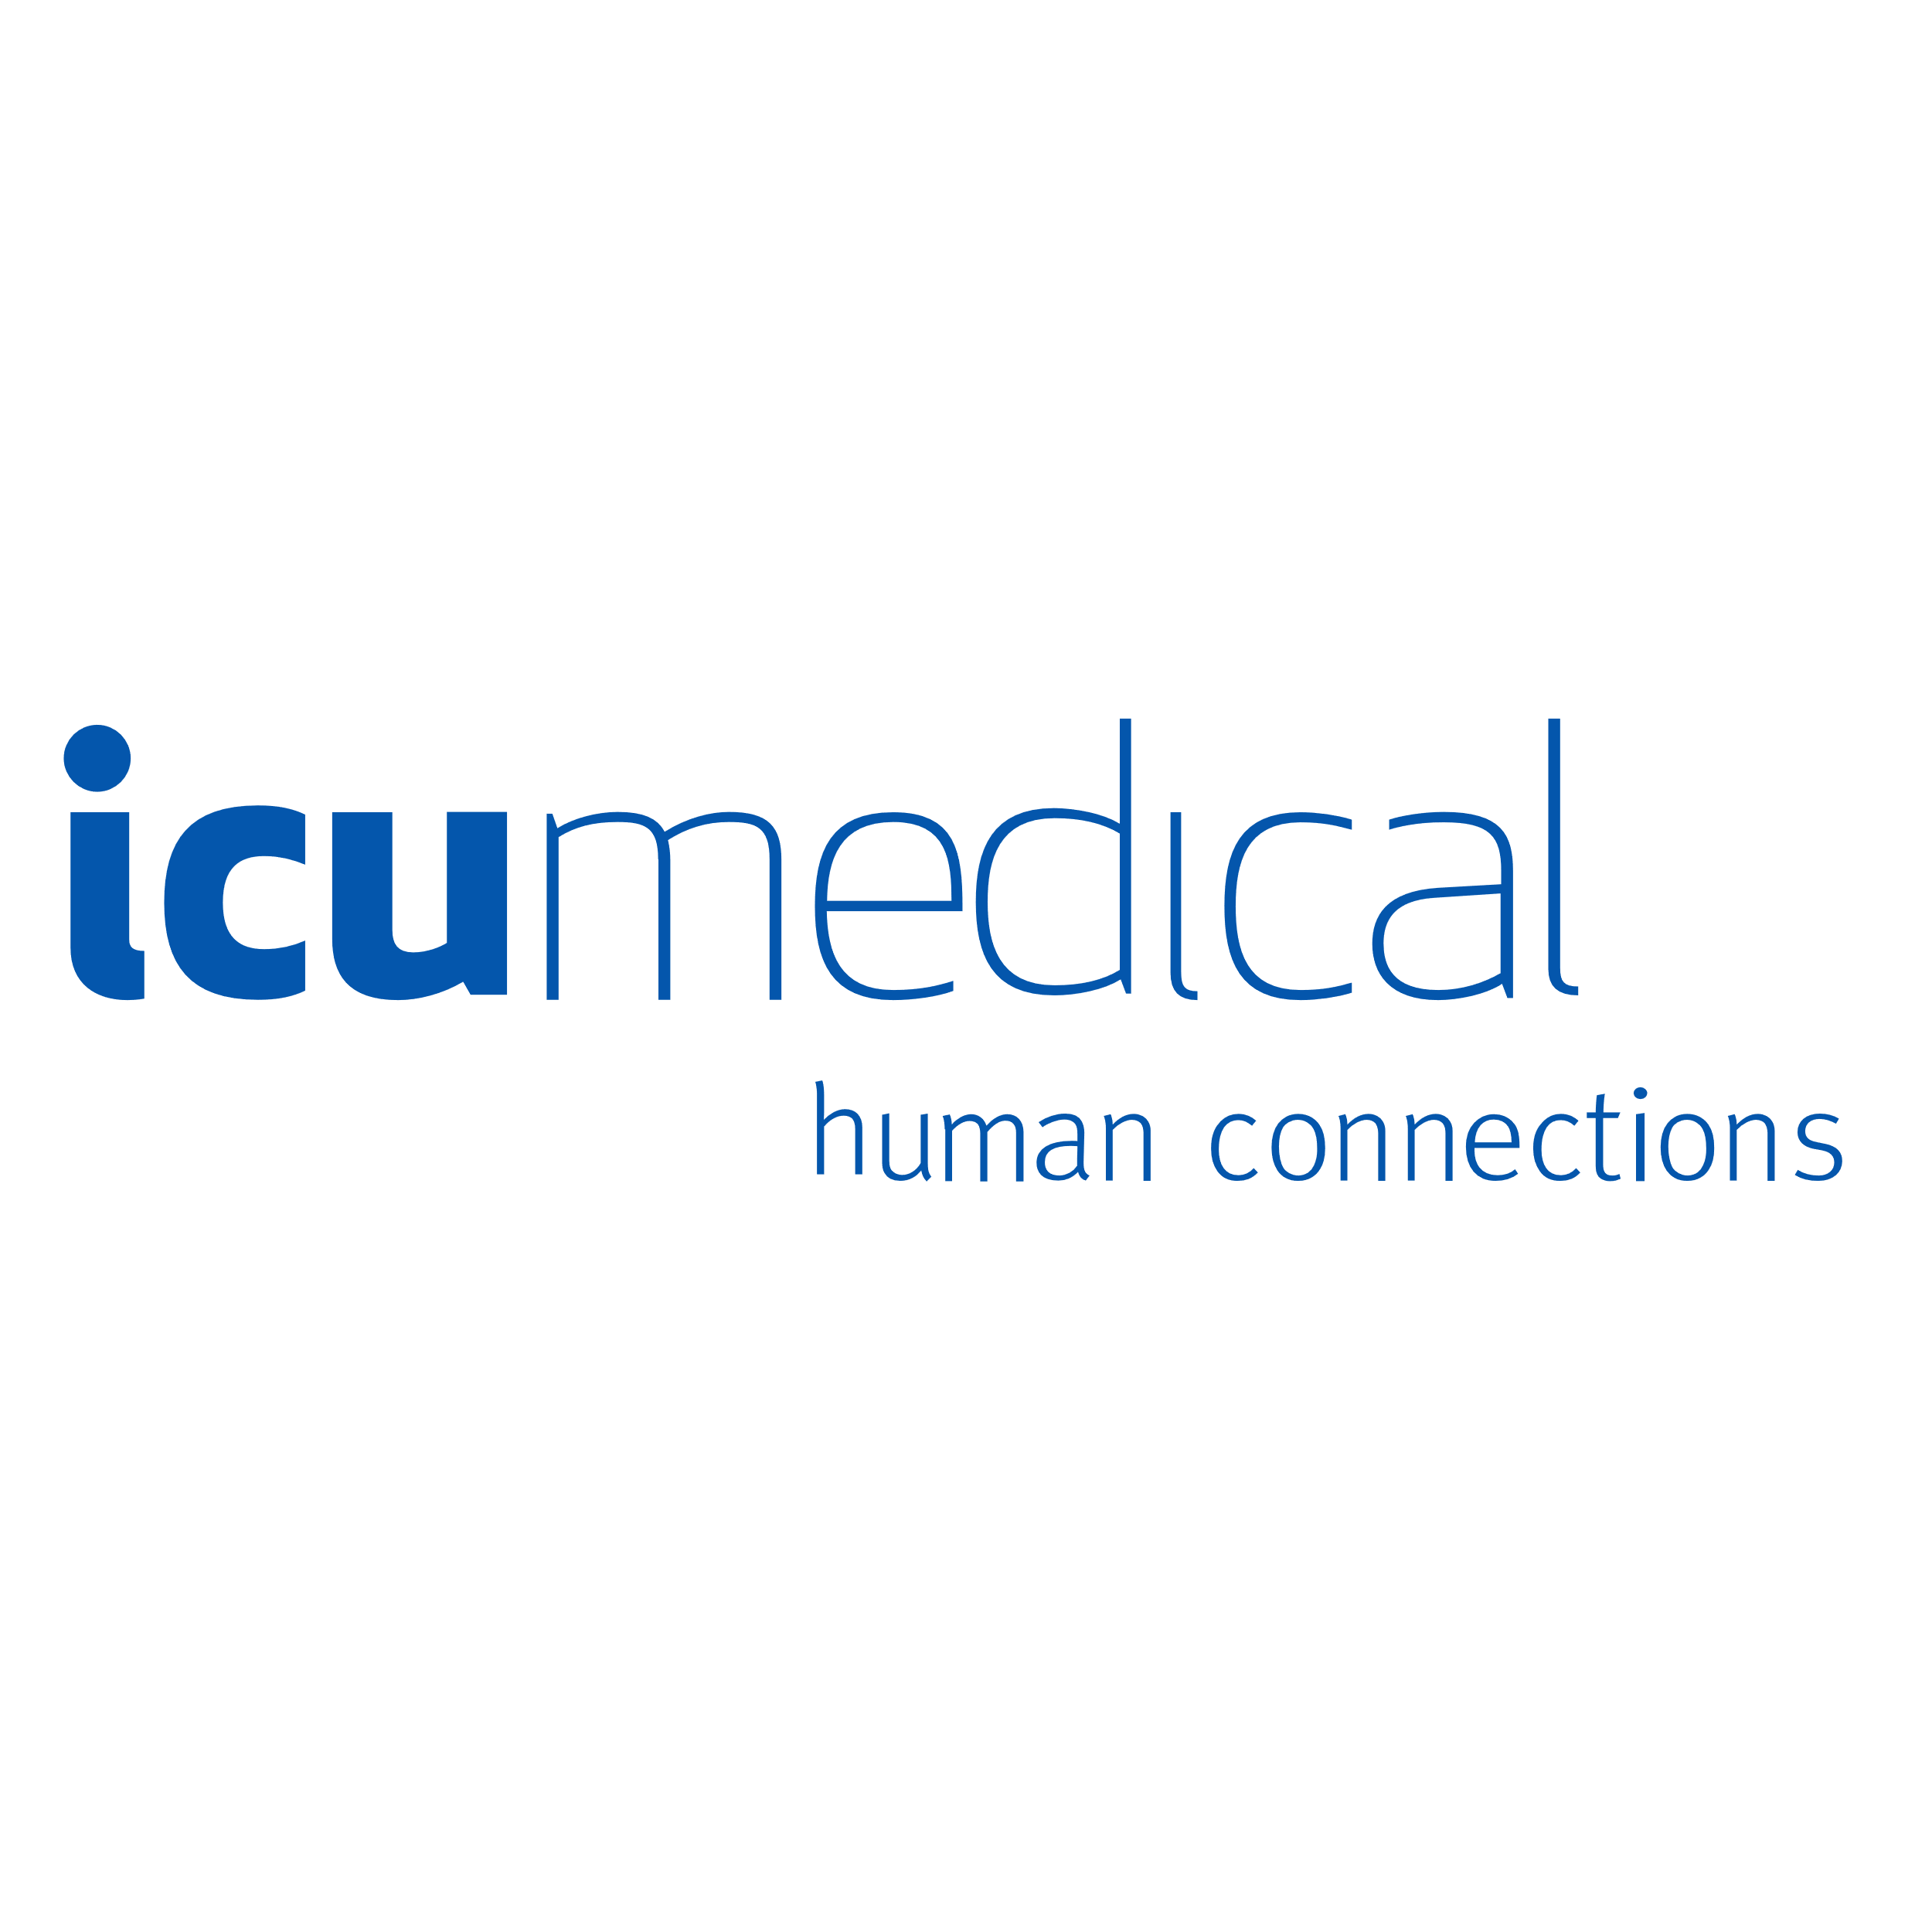


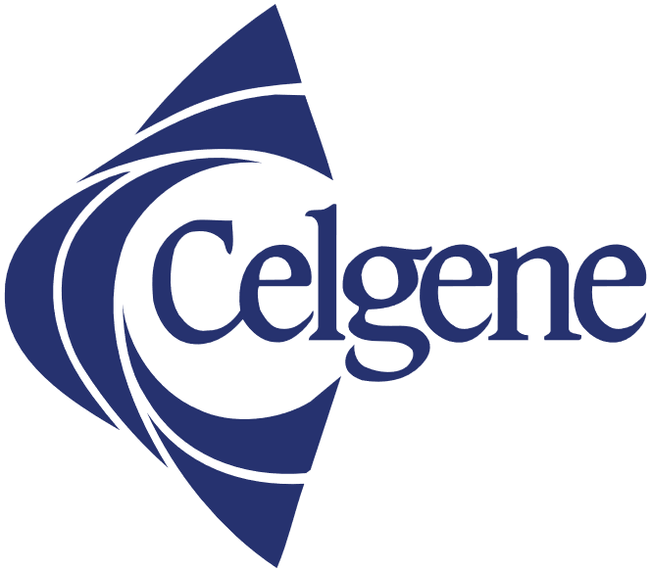





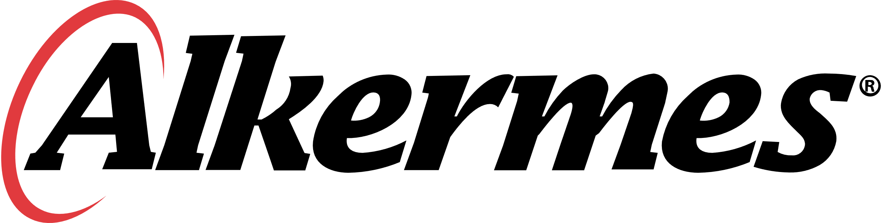


Life sciences leaders use ValGenesis VLMS …
Biotechnology
Pharmaceuticals
MedTech
Notes:
There are a lot of great stories behind these logos.
[[[ MATCH A LOGO WITH ONE THAT’S CLOSE TO YOUR CUSTOMER ]]]
Let’s focus on Bayer … customer for XX years, now grown to XXX.
Or Roche and Genetech … first-mover, adopter of e-logbook and CSV …
Dexcom … using us to run manufacturing equipment and the custom software that runs on that equipment
Cytiva …

Slide 8


… and see real business results
Biotechnology
Pharmaceuticals
MedTech
We can perform seamless validations across the globe with quick turnaround.
We reduced the validation cycle time by over 50%.
ValGenesis VLMS has tremendously reduced manual work and improved compliance through system-driven interlocks.
We eliminated human errors and removed 50% from the validation cycle time.
Now it takes 90% less time to complete testing activities. 40 audits resulted in zero audit findings on the validation records.
Validation related observations dropped 90%
after implementation.
Notes:
ANOTHER OPPORTUNITY TI TELL ANOTHER CUSTOMER SUCCESS STORY

Slide 9

Top ten reasons why customers select and grow the ValGenesis VLMS
#10
#9
#8
#7
#6
Company
stability and longevity
Mobile app
with offline support
Integration with validated API
Multisite and multilingual for global deployment
Real-time traceability matrices
#5
#4
#3
#2
#1
Defensible ALCOA+
data integrity
Agile-ready
Risk-based requirements and system assessment
CSA-ready, supports risk-based critical thinking
Single platform for validation, logbooks, cleaning and CPV
Notes:
#10: Company stability and longevity. We’ve been around for nearly two decades, have grown by double digits almost every year, and have earned the trust of the biggest names in life sciences. We’re backed by Morgan Stanley, profitable, and not going anywhere.
#9: Mobile app with offline support. Execute and approve the validation deliverables without network connections.
#8: Integration capability. Our validated API stack can interface with other GMP systems.
#7: Multisite and multilingual for global deployment. We can scale to support the largest implementations to enforce standardization at a global level.
#6: Real-time traceability matrices. These are dynamic and automatically generated, saving untold hours in labor and enabling teams to rapidly match requirements with tests.
#5: Defensible ALCOA+ data integrity. Electronic signatures, timestamps, and more automatically fulfil and exceed the data integrity requirements of documentation. And it’s all captured automatically.
(Attributable, Legible, Contemporaneous, Original, Accurate + Complete, Consistent, Enduring, Available)
#4. Agile ready. Support iterative methodologies and any type of testing, including ad hoc and scripted, to align validation with development cycle.
#3. Risk-based requirements and system assessment. The VLMS considers risk at every level, and also supports almost every risk assessment tool like FMEA, FTA, Decision tree, and much more.
#2. CSA ready. Support risk-based critical thinking and fulfil the requirements of CSA out of the box.
#1. Single platform for validation, logbooks, cleaning, CPV. A full-featured platform approach enables true digital transformation through our manufacturing intelligence approach.

Slide 10
Quick recap
What is ValGenesis VLMS
Notes:
Before we go into what’s new, lets set the stage for those in the audience who might not be as familiar with ValGenesis VLMS

Slide 11
ValGenesis VLMS – The Gold Standard in Digital Validation
VLMS provides a unified, data-centric platform for digitizing the entire validation lifecycle, enforcing standardization, ensuring data integrity, reducing risk, lowering the cost of quality, strengthening compliance, and more.
C&Q for Equipment and Facilities | CSA and CSV | Cleaning Validation
VLMS streamlines commissioning and qualification via digitized data collection, testing, and documentation, ensuring efficiency from installation to operational readiness. | VLMS digitizes and simplifies CSV and CSA processes with a risk-based approach that facilitates all testing methodologies and reduces documentation burden. | VLMS automates residue testing, documentation, and reporting, with full support for impact assessments, continuous monitoring, and periodic reviews.
Analytical Method Validation | Logbook Management | Process Validation
VLMS facilitates the assessment of parameters like accuracy, precision, and robustness, ensuring analytical methods are reliable across different laboratories and conditions. | VLMS digitizes and standardizes logs for equipment usage, maintenance, calibration, and other GxP records, providing real-time access to data with offline data capture. | VLMS supports automatic data collection, analysis, and reporting throughout the lifecycle to manufacturing processes consistently produce products that meet quality standards.
Notes:
ValGenesis VLMS 5.0 continues to support every validation process. It is CSA-ready out of the box with support for risk-based requirements and ad hoc testing. It also supports commissioning and qualification of equipment and facilities, cleaning, analytical method, and process validation.

Slide 12
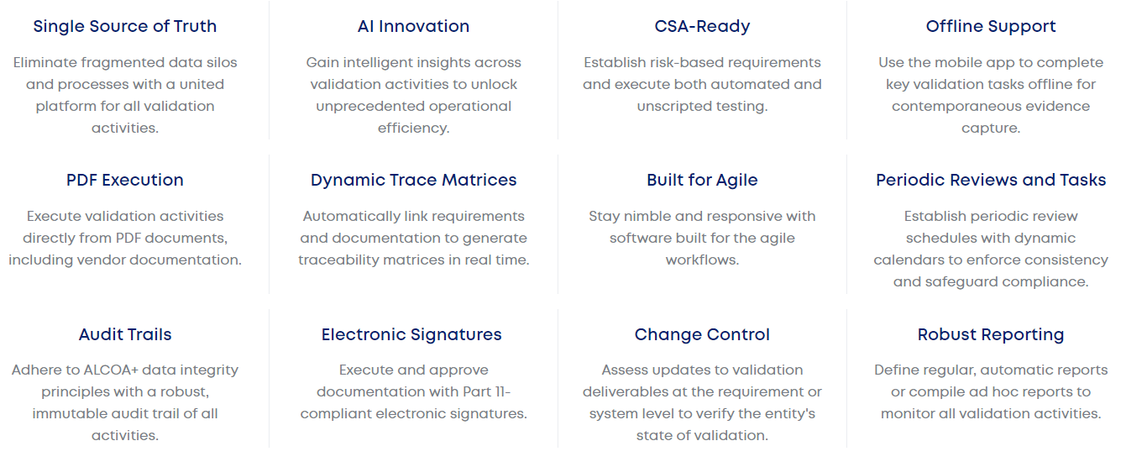
ValGenesis VLMS Key Features

Slide 13
What you’ll see today in our presentation
Points
That directly reflect
What we know about the customer
From the qualification and/or
Discovery calls
That help reiterate
We heard them
And we can help them

Slide 14
Demo
With Emmanuel Cansino / Your SET Person

